Slide 1
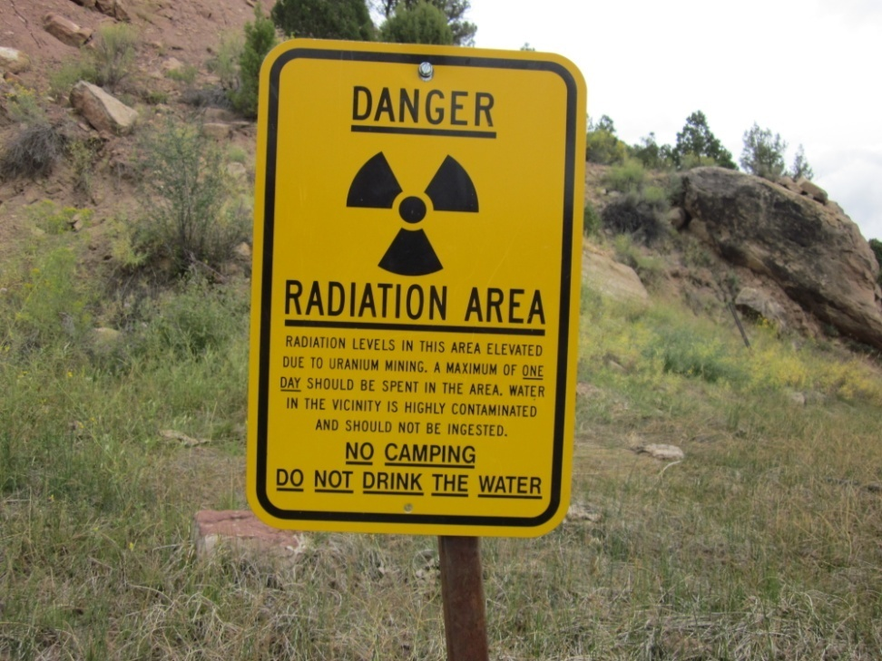
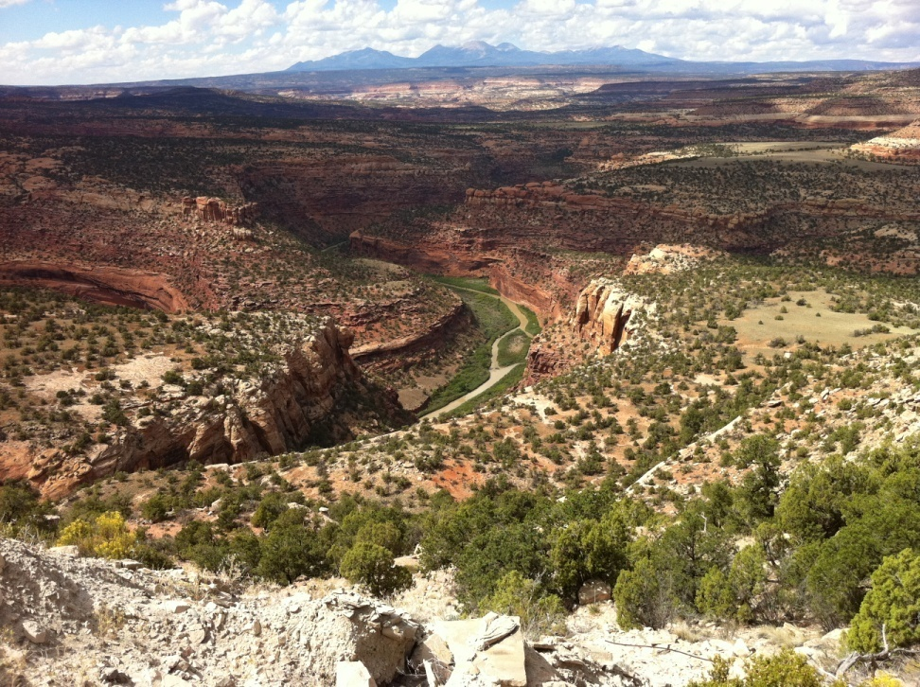
Colorado Inactive Uranium Mine Reclamation Health and Safety Procedures
Steve Renner
Senior Project Manager
Colorado Inactive Mine Reclamation Program
Grand Junction, Colorado

Slide 2
Colorado Division of Reclamation, Mining and Safety, Inactive Mine Reclamation Program
Safeguard public from hazards presented by inactive mines;
Identify sites;
Define issues;
Design solutions;
Construct solution using third party contractors

Slide 3
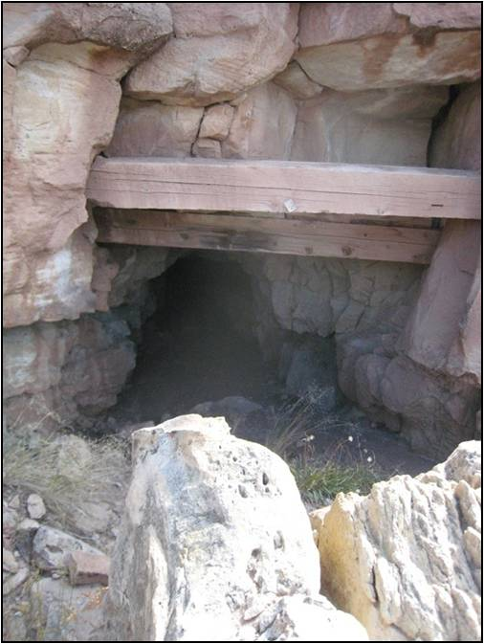
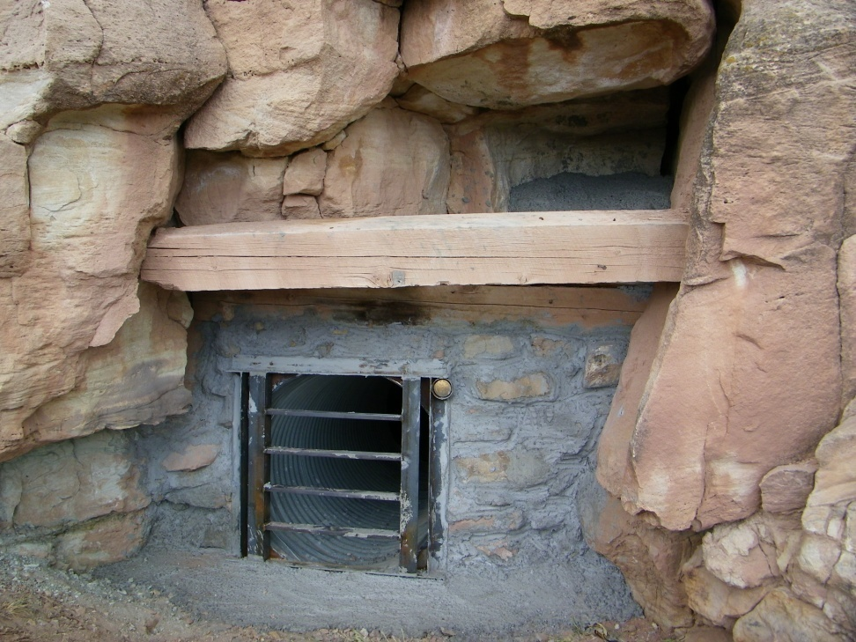
Construction (reclamation) generally consists of building Mine Safety Closures;
Staff on site before, during reclamation;
Contractor on site during reclamation;
Some work on surface, some underground.

Slide 4
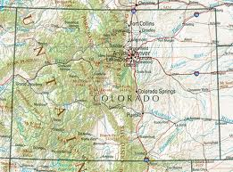
Map of Uravan Mineral Belt, Colorado and Utah

Slide 5
Radiation Hazards
Two radiation hazards at inactive uranium mines; gamma and radon related.

Slide 6
Radiation of Interest
Gamma
Alpha
Particulate
Very Low Penetration;
Quick atmospheric dispersion;
Shield by skin, clothing, paper;
Biologic Hazard: Internal
- Wave;
High Penetration Power;
Shield by lead, concrete, steel;
Biologic Hazard: Whole Body

Slide 7
Units of Measurement
Units of measurements for
Strength of a source
Energy of radiation
Level of radiation in the environment
Amount of radiation absorbed by the body (Dose)
See Canadian Centre for Occupational Health and Safety; Radiation Facts
Working Level is a measure of the concentration of radon progeny in a unit volume of air;
A Working Level Month (WLM) describes exposure to one working level of radon progeny (energy) in 170 hours; Exposure to energy over time.
Health considerations based on Working Level Months (exposure over time).

Slide 8
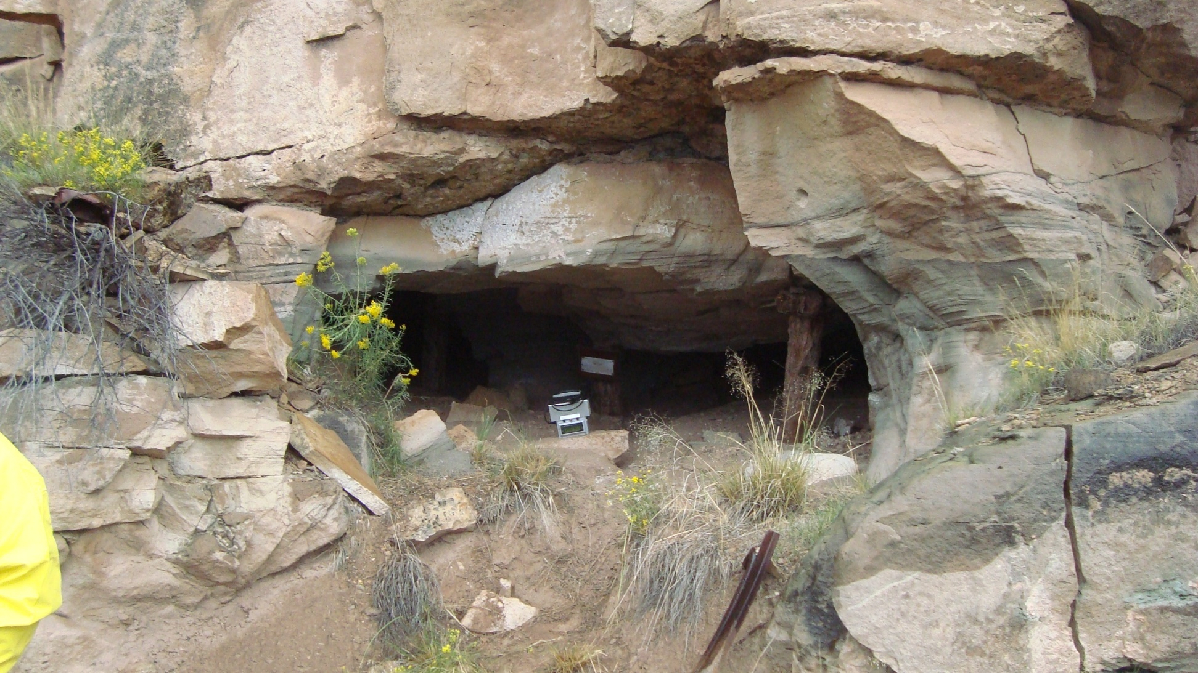
Sources of Radiation at Inactive Uranium Mines
Gamma Sources:
Carnotite, Uraninite, Vanadium
Overburden waste (surface mines)
Waste rock (underground mines)
Spilled or low grade (non-economic) ore
Alpha Source:
Radon progeny emanating from underground entries

Slide 9
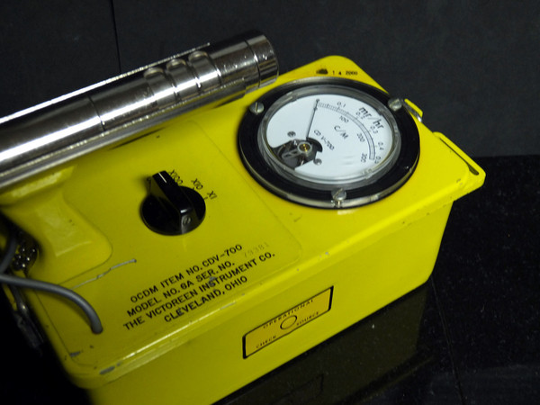
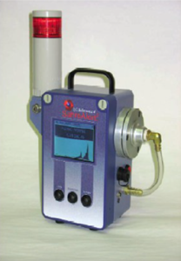
Early Health Concerns
Original health and safety focus was on gamma radiation exposure;
Evaluated gamma site by site;
Little attention paid to alpha exposure;
Very few sites secured
Risk assessment evolved over time;
Alpha (radon progeny) recognized as biggest risk factor when reclaiming inactive uranium mines.

Slide 10
Next Steps
Few inactive uranium mine reclamation projects 1990’s, early 2000’s;
Reclamation construction ramps up;
Recognition of Alpha hazard

Slide 11
Next Steps
Developed Alpha centered Health and Safety Guidelines;
Establish exposure limitations;
PPE dependent;
NIOSH study 2012

Slide 12
Next Steps
NIOSH results in:
Minor reduction in exposure limitations;
Dependence on cultural / engineered controls versus PPE as primary protection;
NIOSH endorses Colorado protocols;
BLM evaluating whether to adopt nationally.

Slide 13
Radon Hazards
Radon Progeny are of concern at inactive uranium mines due to many factors including mine atmosphere, and placement of safety closures within a mine entry;
Radon Progeny emit from recesses of underground mines; are airborne and have an affinity for dust.

Slide 14
IMRP Approach to Radiation Hazards at Inactive Uranium Mines
Acknowledge radiation hazards;
Keep in perspective with other inherent site hazards;
Minimize potential health risks.

Slide 15
ALARA
(As Low As Reasonably Achievable)
The ALARA principle arises from the fact that infinite time, effort and money could be spent in attempting to reduce risk to zero.
ALARA is not simply a quantitative measure of benefit against detriment.
ALARA is a best common practice of balancing potential risk and potential benefit.
For IMRP, this means that we take appropriate precautions to ensure no one becomes sick as a result of performing work tasks at Inactive Uranium Mines.
To that end, IMRP has developed health and safety protocols which are protective of individuals working at these unique sites.
Alpha - airflow dependent – use respirator or evacuate
Beta – inconsequential at abandoned mine sites (may be of concern at concentrating facilities)
Gamma – shielding impractical; limit time of exposure and maximize distance from source.

Slide 16
IMRP Approach to Radiation Hazards at Inactive Uranium Mines
Developed policy guidance that places safety burden on both staff and contractors;
Staff makes gamma and radon progeny measurements at each site.
Contractor reacts to potential hazards by taking proactive steps during construction.

Slide 17
IMRP Approach to Radiation Hazards at Inactive Uranium Mines
Alpha, gamma measurements drive monitoring and hazard mitigation requirements;
Hazard mitigation requirements are binding part of construction contracts.

Slide 18
Safety Principles
Everyone goes home safely at the end of the day;
No impacts to our health from work;
Hazard mitigation is appropriate for risk;
PPE does not enhance risk from other job site hazards.

Slide 19
Safety Principles Define Acceptable Exposure (Dose) Administrative Goals:
Gamma exposure not to exceed 2.0 Rem / Year
Monitor and record time and average gamma on site;
Radon progeny exposure not to exceed 1.55 Working Level Months / Year
Contractor staff at no more than 1,000 hours / year exposure time;
IMRP staff at no more than 800 hours / year exposure time

Slide 20
Establishing Background Gamma
Gamma measured and recorded at each site;
Measurements located with GPS (Restoration);
Personal dosimetry required for all personnel;
Time on site recorded for all personnel.

Slide 21
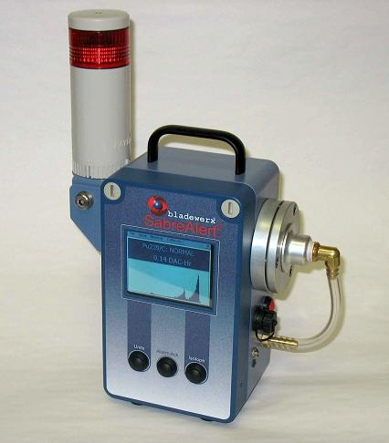
Establishing Background Radon Progeny
Radon Survey
Using real time instrument;
Portable, moderately rugged machine;
Provides measurement in milli Working Levels;

Slide 22
Establishing Safety Precautions Radon Progeny
Multiple measurements per site pre-construction;
Continual measurement during Construction.
Highest recorded measurement dictates safety requirements.

Slide 23
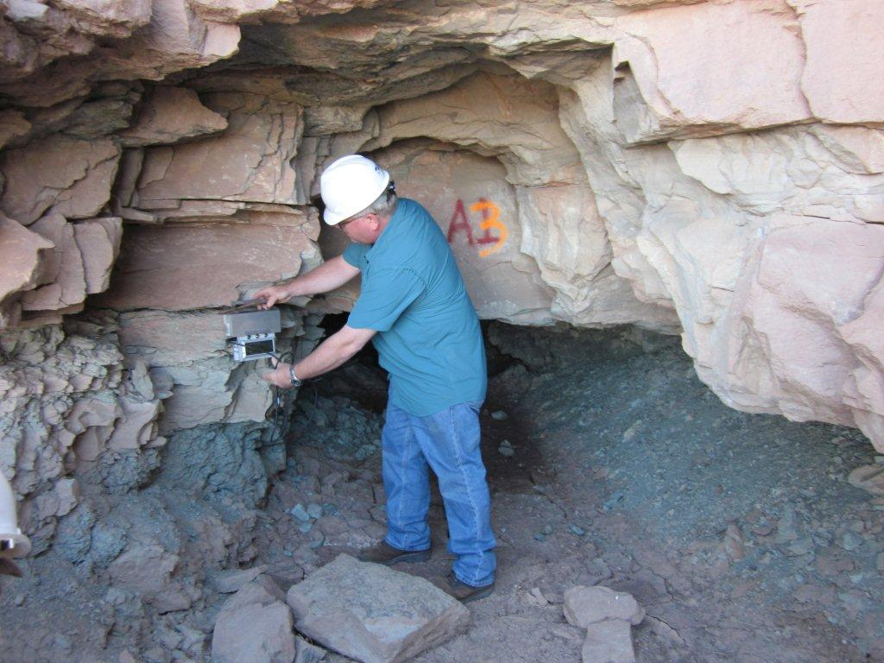
Establishing Safety Precautions Radiation Field Survey Data
Entry Type and connectivity to adjacent entries;
Mine Ventilation Characteristics;
Weather observation (barometric pressure variation);
Gamma Measurements at entry and waste dump;

Slide 24
Radon Progeny Limitations
- No controls or PPE required at or below 0.09 Working Levels;
0.10 – 2.45 WL: Implement cultural practices / engineering controls; I/2 Face P100 MSHA / NIOSH Respirator (PPE);

Slide 25
Radon Progeny Safety Requirements
2.46 – 5.01 Working Levels
Positive ventilation of work area required prior to entry; Implement cultural practices / engineering controls; PPE;
5.02 Working Levels and over: Entry only with Self Contained Breathing Apparatus (Certification to use equipment required).

Slide 26
Other Radon Progeny Standards / Recommendations
MSHA:
½ face respirator at 1 - 5 WL
Ventilate work area at 5 – 10 WL
SCBA at 10 + WL
NIOSH:
Suggests initial PPE at 0.08 WL;
Calculated based on 2,000 hours of exposure per year

Slide 27
Construction Cultural and Engineering Practices, Alpha Sequence and Methods of Closure
Complete work so that natural ventilation acts to surpress exposure;
Dust suppression during work;
Construct Brattice or form-fit atmosphere barrier prior to work;
PPE may be relaxed for mechanical shaft and adit backfills.

Slide 28
Construction Cultural and Engineering Practices, Alpha
Construction Methods to Minimize Exposure Risk :
Use of water to control dust at bulkhead closure

Slide 29
Construction Cultural and Engineering Practices, Alpha
Construction Methods to Minimize Exposure Risk:
Use of barricade to reduce or eliminate air flow

Slide 30
Construction Cultural and Engineering Practices, Alpha
Construction Methods to Minimize Exposure Risk:
Define ventilation patterns so outcasting at construction area is minimized or eliminated;
Accommodate barometric changes in work schedule.

Slide 31
Construction Cultural and Engineering Practices, Alpha
Construction Methods to Minimize Exposure Risk:
Work away from radon rich environment

Slide 32
Construction Cultural and Engineering Practices, Gamma
Construction Methods to Minimize Exposure Risk:
Use of equipment with enclosed, positive ventilation cab

Slide 33
Construction Cultural and Engineering Practices, Gamma
Construction Methods to Minimize Exposure Risk:
Use of water to eliminate dust during earthwork

Slide 34
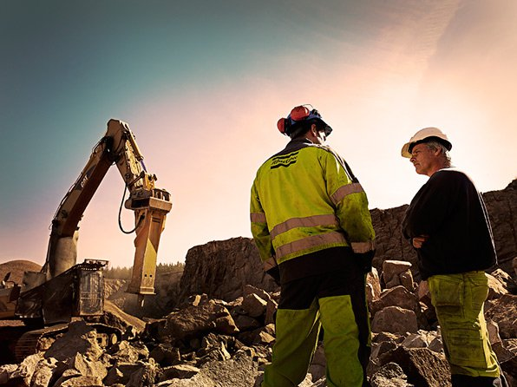
Construction Cultural and Engineering Practices, Gamma
Monitor gamma; minimize time on site

Slide 35
Summary Time, Distance, Shielding and ALARA
Cultural and engineering controls during reclamation may reduce radon progeny concentrations / exposure at work area (ALARA);
PPE for radon progeny is appropriate at specific concentrations (Shielding);
Exposure times on site are defined, may not be exceeded (Time and Distance);
Radon progeny exposure thresholds based on proximity to entry (Distance) and time on site;
IMRP established Administrative Dose Goal for Alpha, Gamma and Total Exposure (ALARA);
Gamma does not appear to be a health issue at Uravan Mineral Belt Inactive Uranium Mines;
Monitoring at each site occurs, regardless (ALARA);
Time on site limitations;
Radon progeny (alpha) is a potential health risk for State and Contractor staff (ALARA);
Measurements made before and during construction help define risk (ALARA);

Slide 36
Questions?

