Slide 1
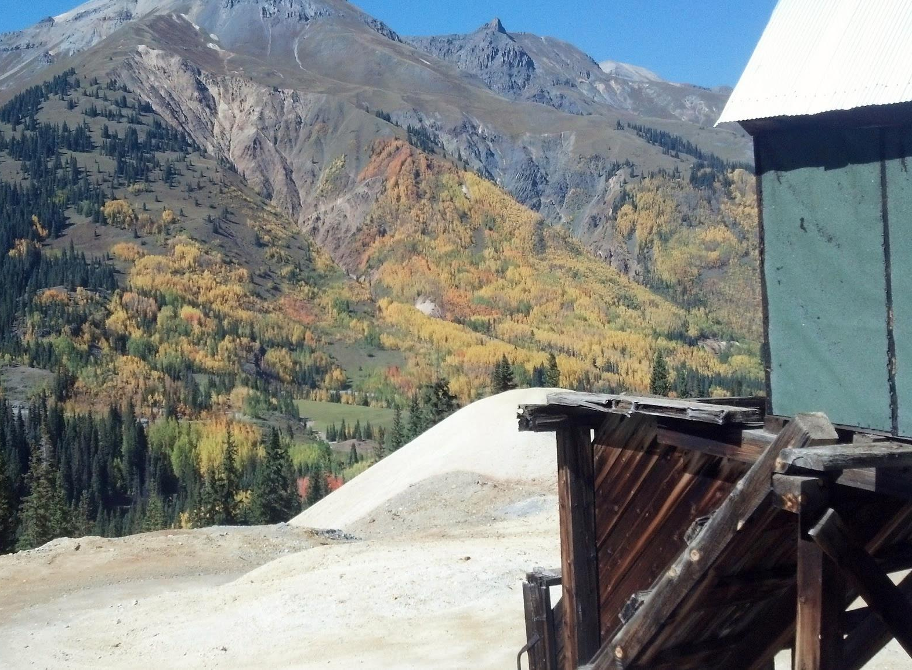
Passive Treatment in the
San Juan Mountains
Challenges, Ideas, and Solutions
Devon Horntvedt, P.E.
Worthington Miller Environmental for Idarado Mining Company

Slide 2
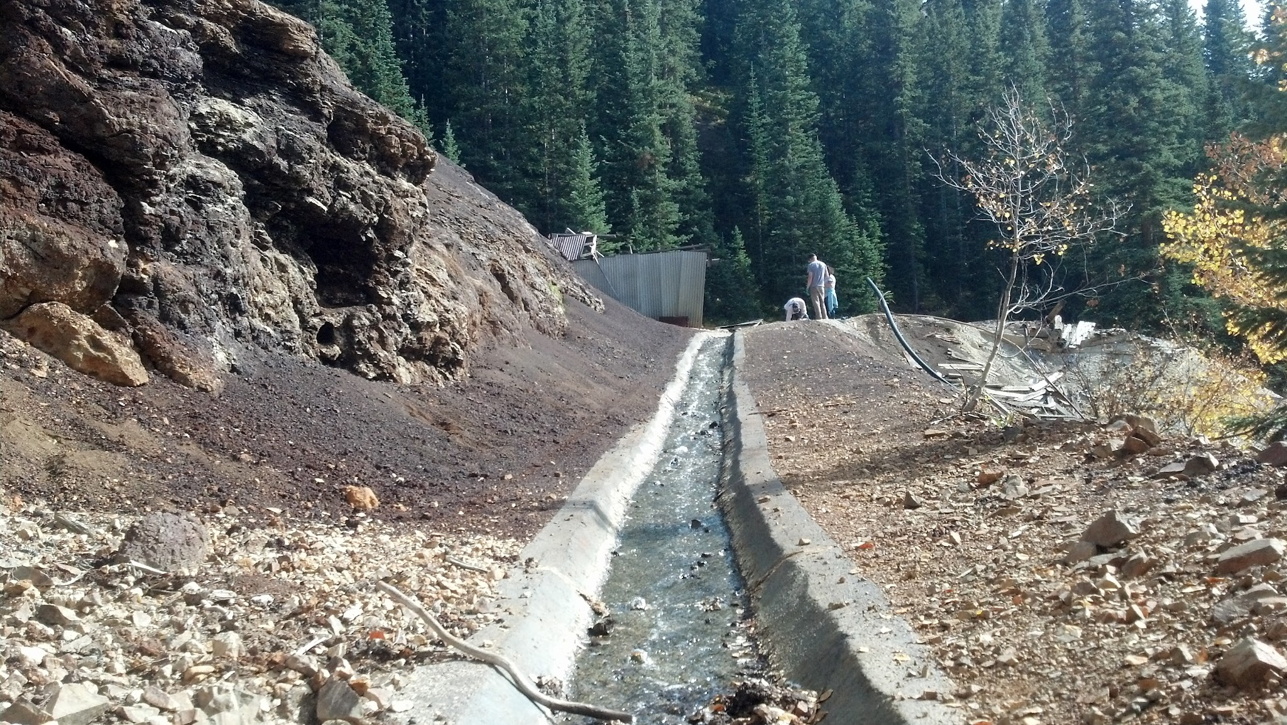
Consent Decree and Remedial Action Plan
Required a 50% reduction in zinc concentrations in Red Mountain Creek (RMC)
Initial efforts focused on source controls (tailing consolidation, diversion ditches, infiltration zones)
Contingency Plan
Additional zinc source characterization performed in 2012
Evaluation of potential remedial alternatives progressed in 2013 and 2014

Slide 3
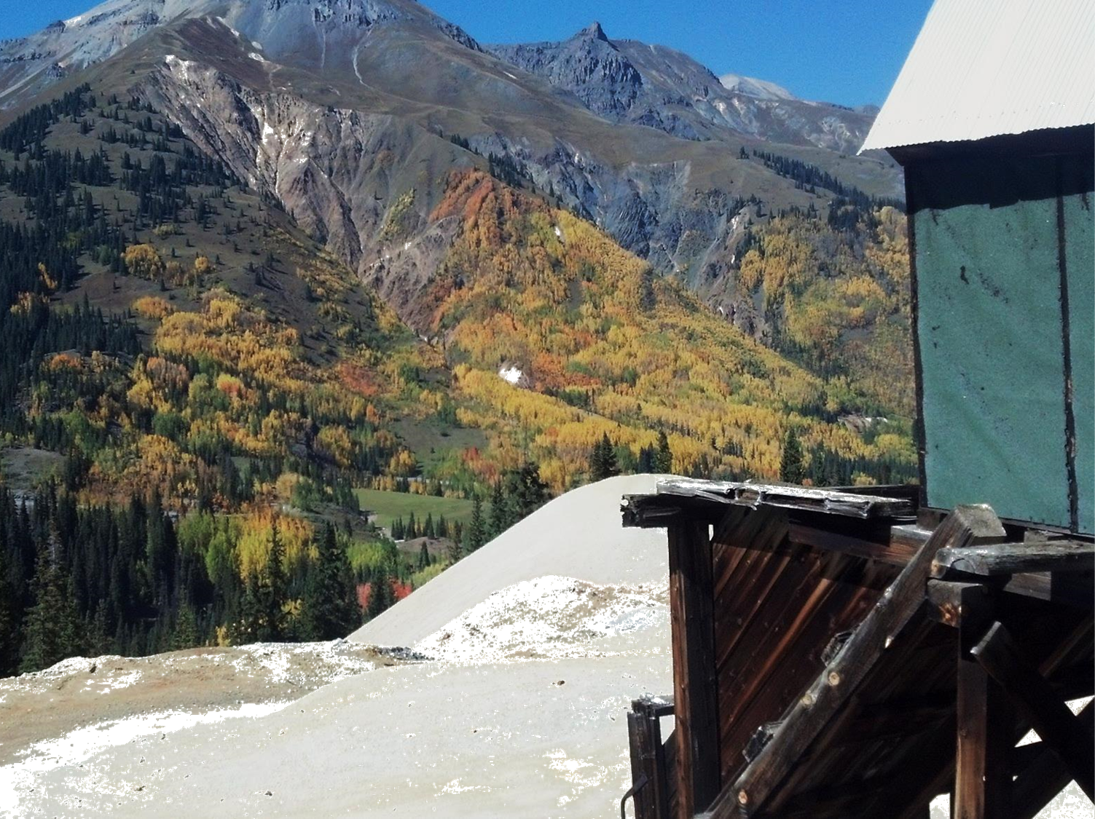
Acid Rock Drainage: Why? Where? How?
Water+ Oxygen + metal sulfides
Overall pyrite oxidation reaction
FeS₂ + 7/2O₂ + H₂O = Fe²⁺+ 2SO₄²⁻ + 2H⁺
Contributing reactions:
Ferric iron oxidation of pyrite
FeS₂ + 14Fe³⁺ + 8H₂O = 15Fe²⁺ + 2SO₄²⁻ + 16H⁺
Ferrous iron replenishes ferric iron
Fe²⁺ + ¼O₂ + H⁺ = Fe³⁺ +½H₂O
Ferric iron oxidizes metal sulfides
ZnS + 8 Fe³⁺ + 4 H₂0 = Zn²⁺ + 8 Fe²⁺ + SO₄²⁻ + 8H⁺
Microbial Catalysis
Acidithiobacillus ferrooxidans and thiooxidans operate as iron and sulfur-reducing bacteria, accelerating ferrous to ferric conversion
Ferrihydrite can be generated when pH > 4.5
Fe²⁺ + ¼O₂ + 2½H₂O = Fe(OH)₃+ 2H⁺
Ochre can be generated in higher pH environ
2Fe³⁺(aq) + 6H₂O(l) = 2Fe(OH)₃(s) + 6H⁺(aq)
The International Network for Acid Prevention (INAP), 2009. Global Acid Rock Drainage Guide (GARD Guide).http://www.gardguide.com/

Slide 4
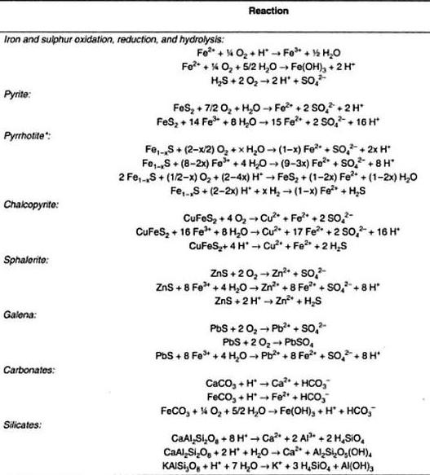
Deb, M., and Wayne David Goodfellow. Sediment Hosted Lead-Zinc Sulphide Deposits. N.p.: CRC, 2004. Print.

Slide 5
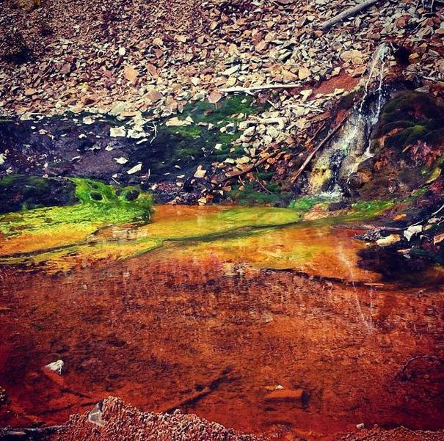

Slide 6
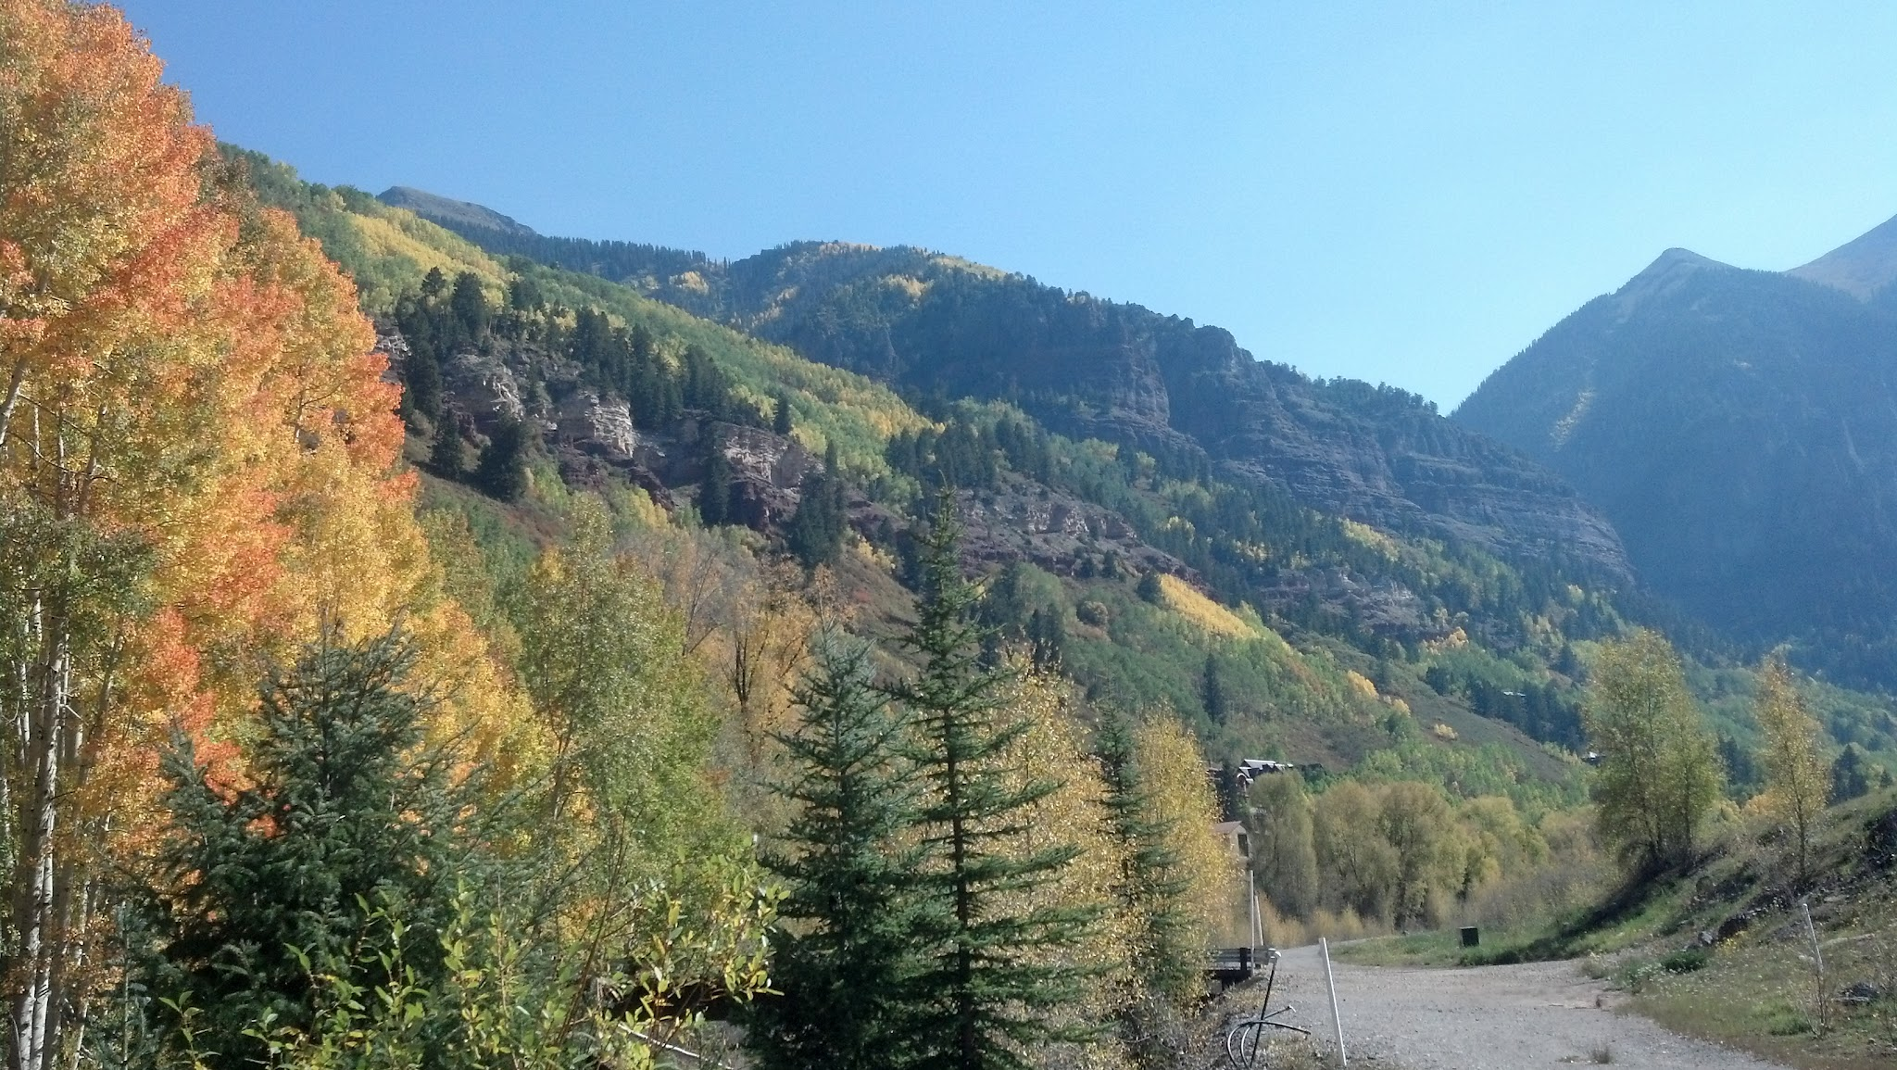
What are the Options?
Prevent ARD formation
Deal with ARD once it has been formed

Slide 7

How can ARD be prevented? (Theoretically)
Eliminate oxygen from our atmosphere
Prevent water from infiltrating entire mountain ranges and contributing to the groundwater table
Completely drain the mountains, preventing sustained hydraulic interaction with metal sulfides

Slide 8
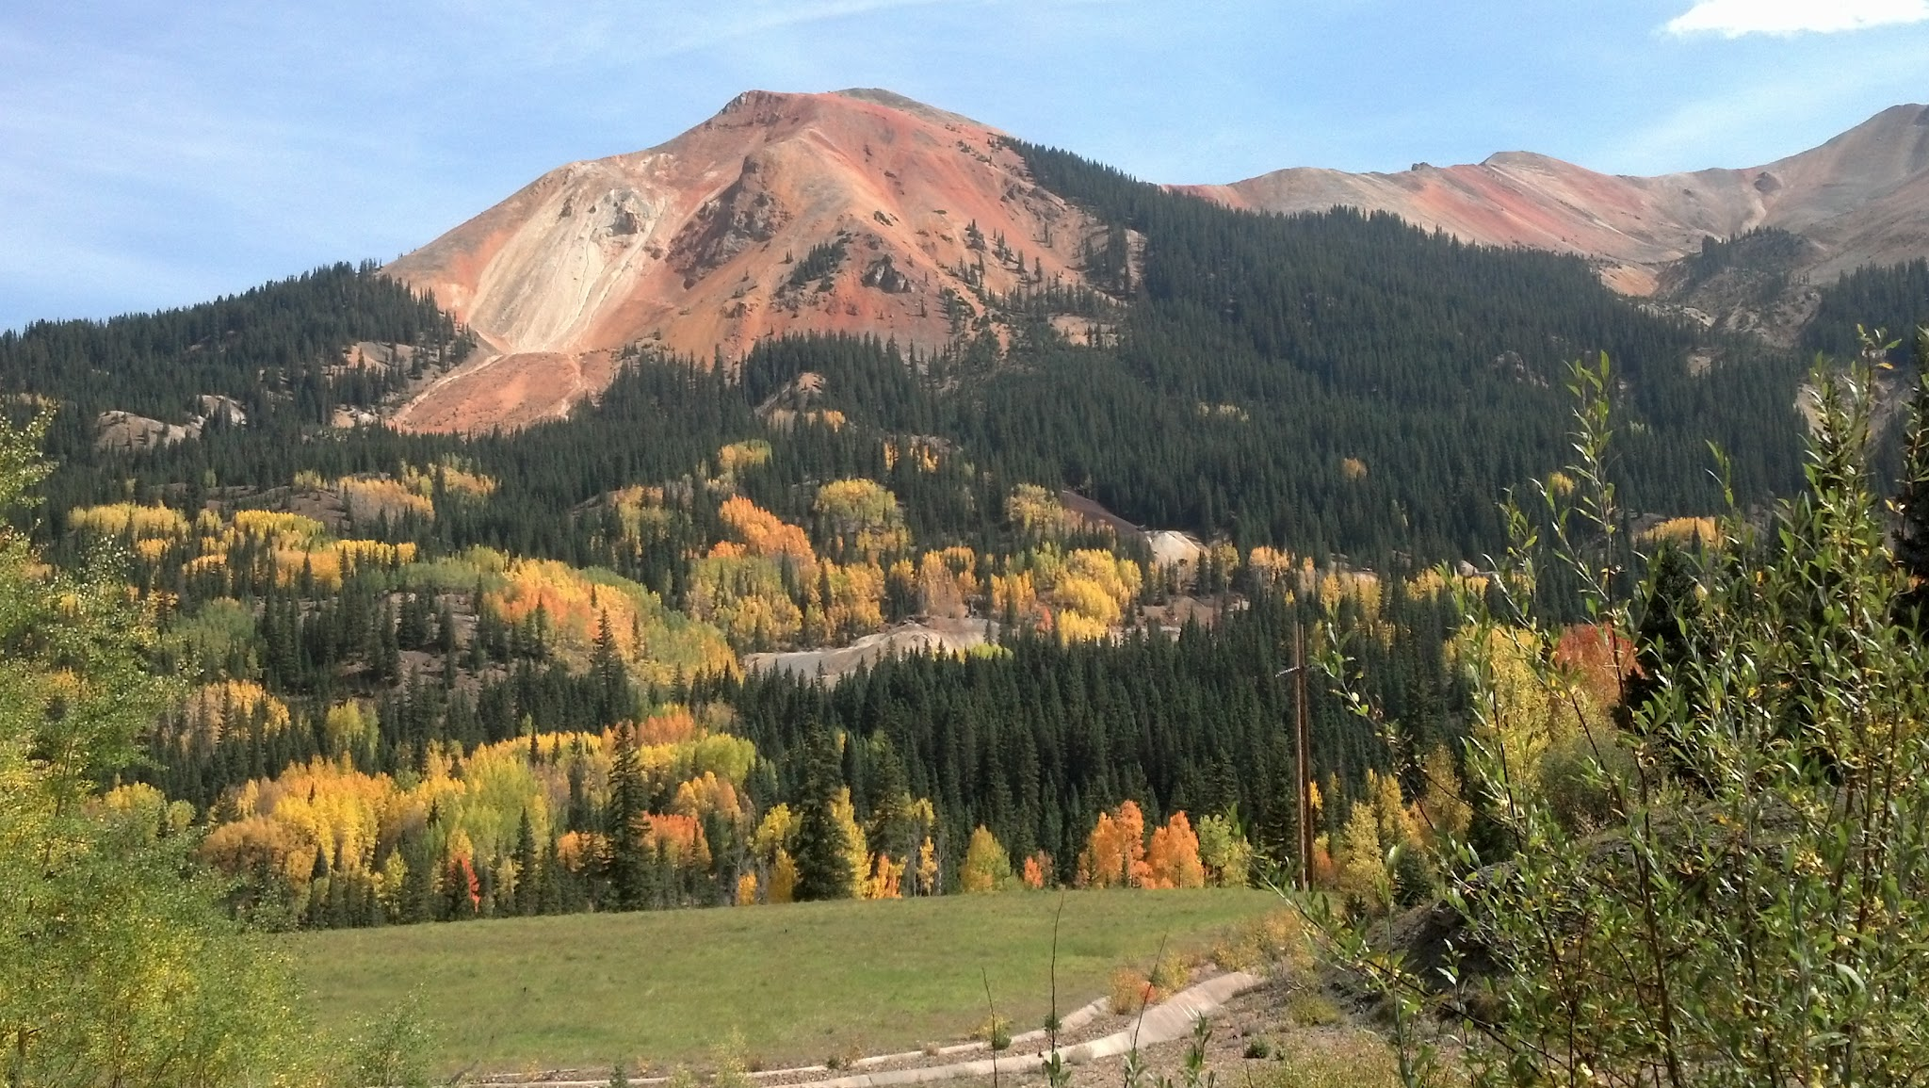
How Can ARD be prevented?
(Practically)
Source Controls
  divert water away from sulfide minerals
  consolidate disparate sulfide wastes, re-vegetate, amend the soils with buffer materials
Prevent O₂ interaction with Mine Pool Water
  Inundation: risky, requires extreme understanding of geochemical and hydrogeological context which is not necessarily possible in massive legacy mine complexes
Bacteriacides

Slide 9
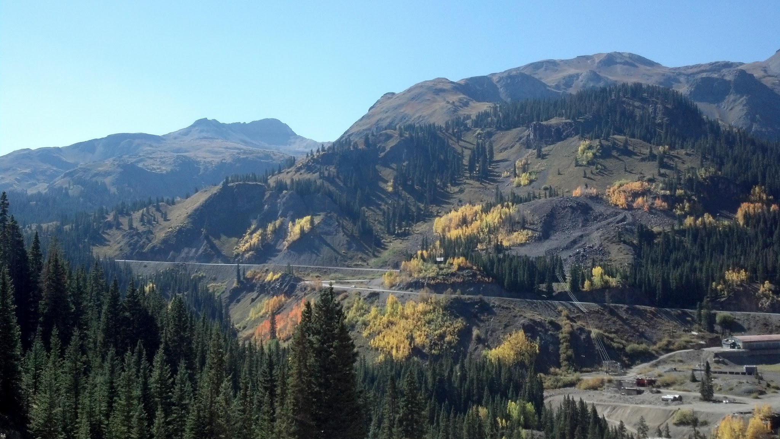
How do we deal with ARD if it already exists?
Active treatment - concentrated chemical manipulation to force desired reactions
Would require:
-electricity
-centralized collection of water, and therefore centralizes risk (pipelines, vandalism, loss of treatment, pumps
-constant personnel and access
-hazmat delivery and traffic
-extreme capital and long term expenditure
Passive treatment

Slide 10
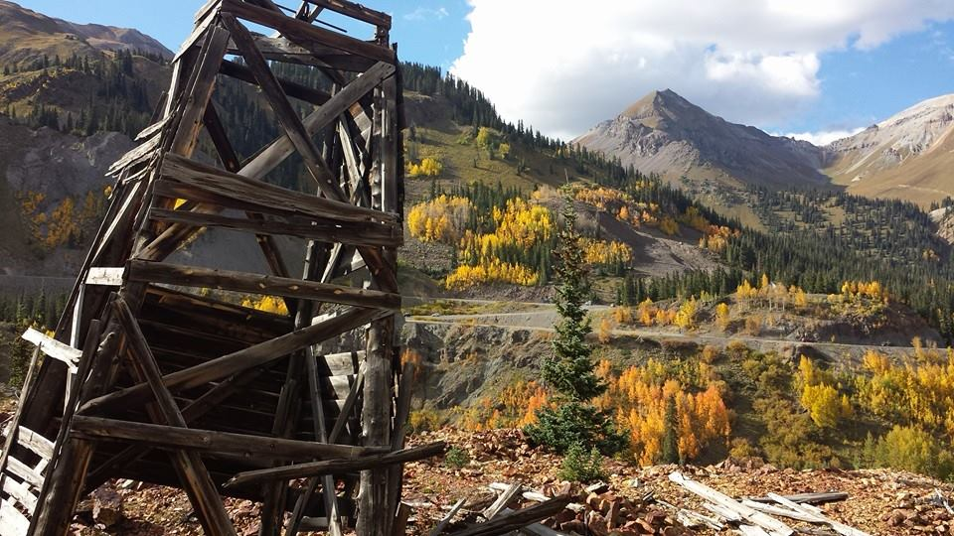
What is Passive Treatment?
Independently powered system, typically gravity-driven
Utilizes engineering to accelerate natural processes to remove contaminants from water
Ideally is sustainable over long terms while requiring minimal maintenance and intervention, at considerably lower costs than active treatment, while also minimizing many of the potential risks

Slide 11
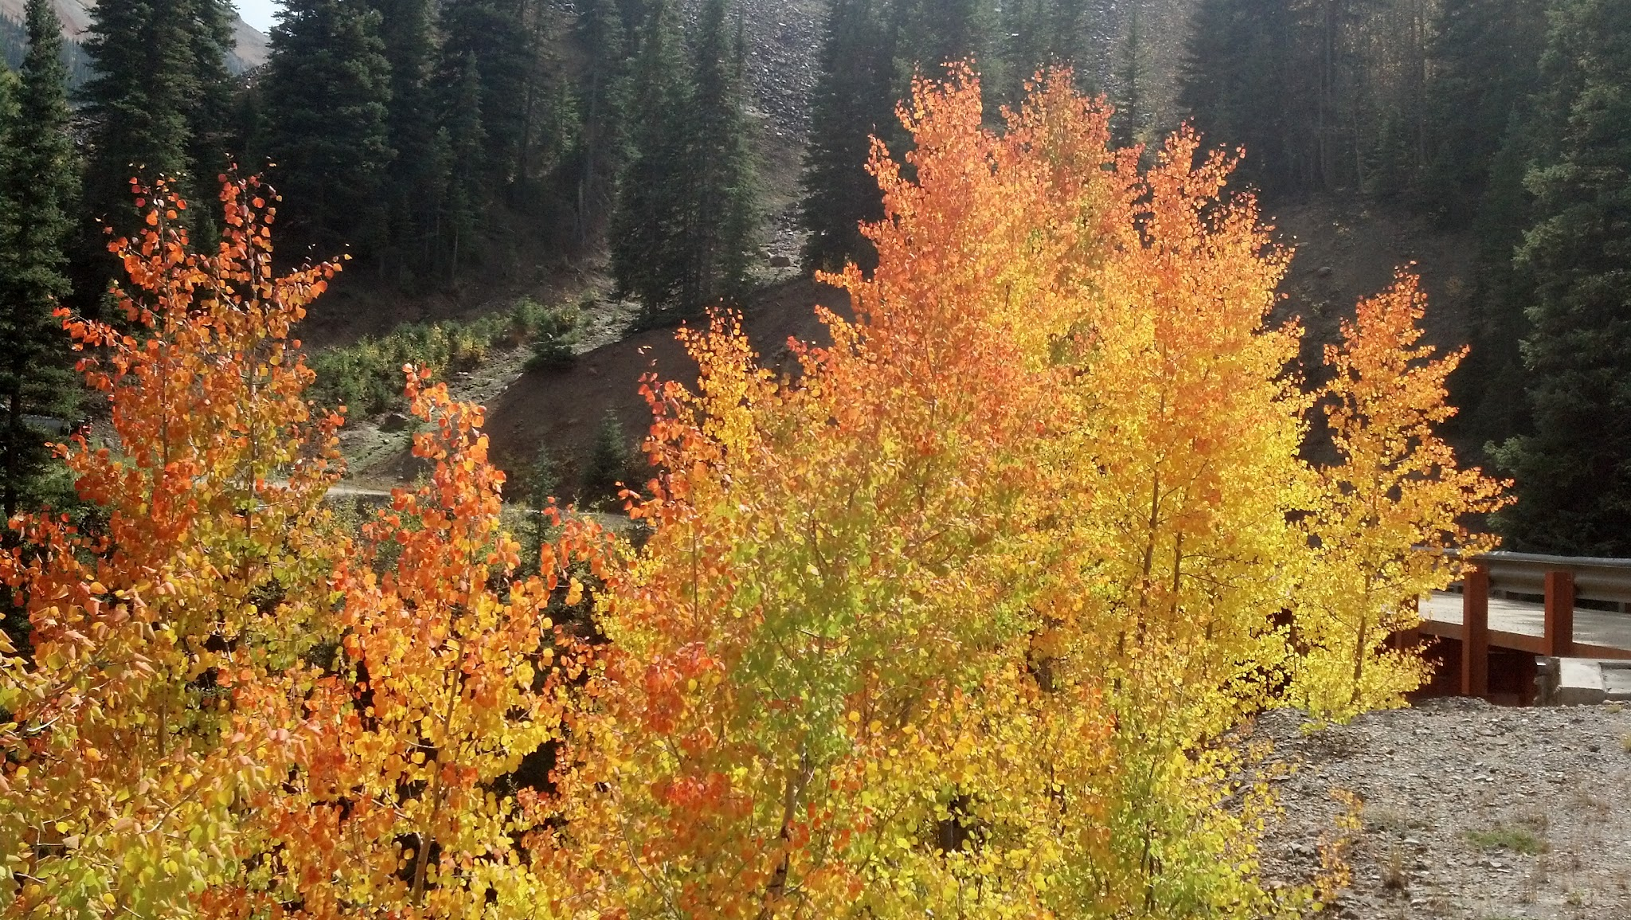
San Juan Passive Treatment Challenges
Exhaustion of chemical media or substrate
Physical plugging
Lack of Dissolved Oxygen/Excess Dissolved Oxygen
Ice, freezing temperatures, and frost heaving
Treatment of difficult constituents (Mn, Zn, Fe^{2+,} Fe³⁺) and high metal loads
Extreme acidity
Required land area and footprint to achieve appropriate Hydraulic Retention Time (HRT)
Difficult to access locations and topography – avalanches, rock slides, no reliable power
Regulatory requirements for extremely low discharge limits

Slide 12
Some Types of Passive Systems
Biochemical Reactors (BCRs) – utilize biological activity to sequester metals
  Sulfate reducing bioreactors, require anoxic influent and large footprint, extreme water chemistry can kill system
  Aerobic wetlands, requires large footprint and low acidity
Abiotic reactors - Use reactive media to alter water chemistry to force preferred chemical reactions
  Oxic and anoxic limestone basins and reactors
  Apatite, activated carbon, ZVI, IRM, SAPS, DAS, other reactive medias in a standalone format or in succession

Slide 13
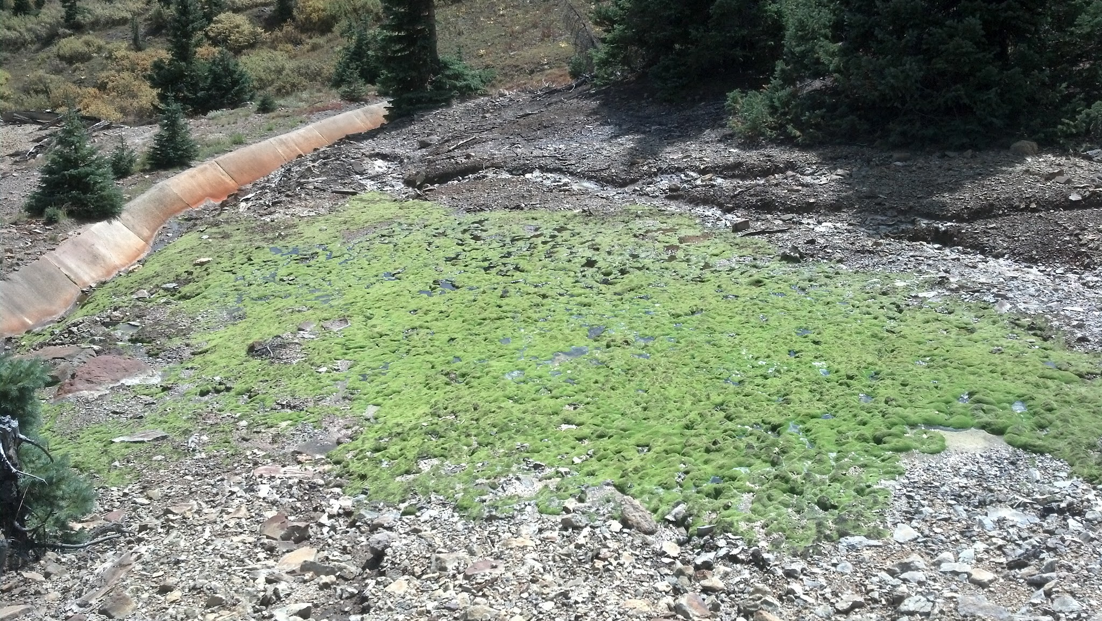
Possible Mechanisms of Action
Forced precipitation of metal (hydr)oxides by increasing alkalinity and raising pH.
- Precipitates can also pull dissolved metal ions out of solution
Ion-exchange media which swaps benign elements for targeted metals
Adsorption
Biological metabolism and sequestration
Phytoremediation - direct metal uptake by plant cells or immobilization in root structure

Slide 14
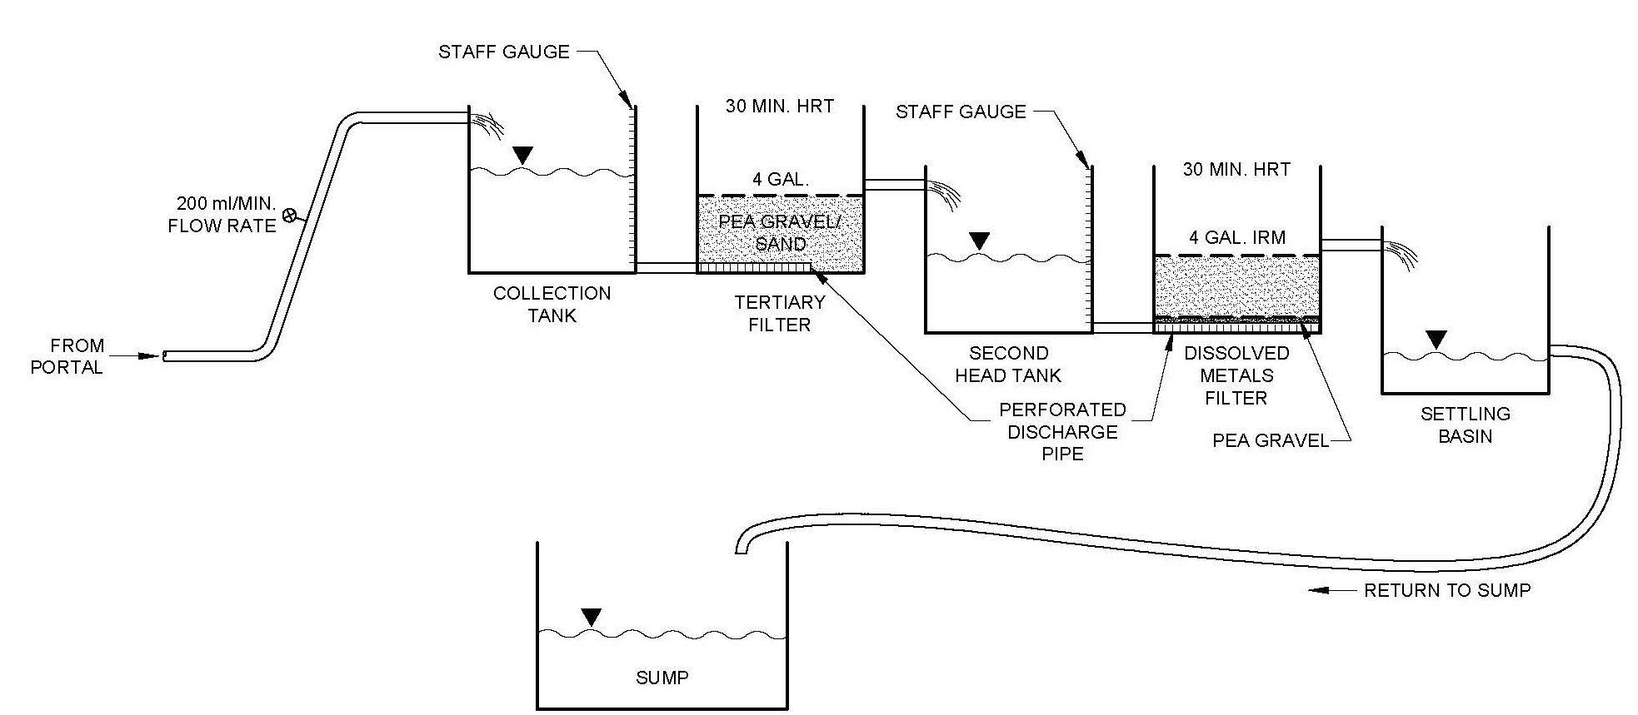
Testing
Batch IRM Testing in Early Fall of 2013
Column IRM Testing in Late Fall of 2013
Pilot testing in Summer of 2014

Slide 15
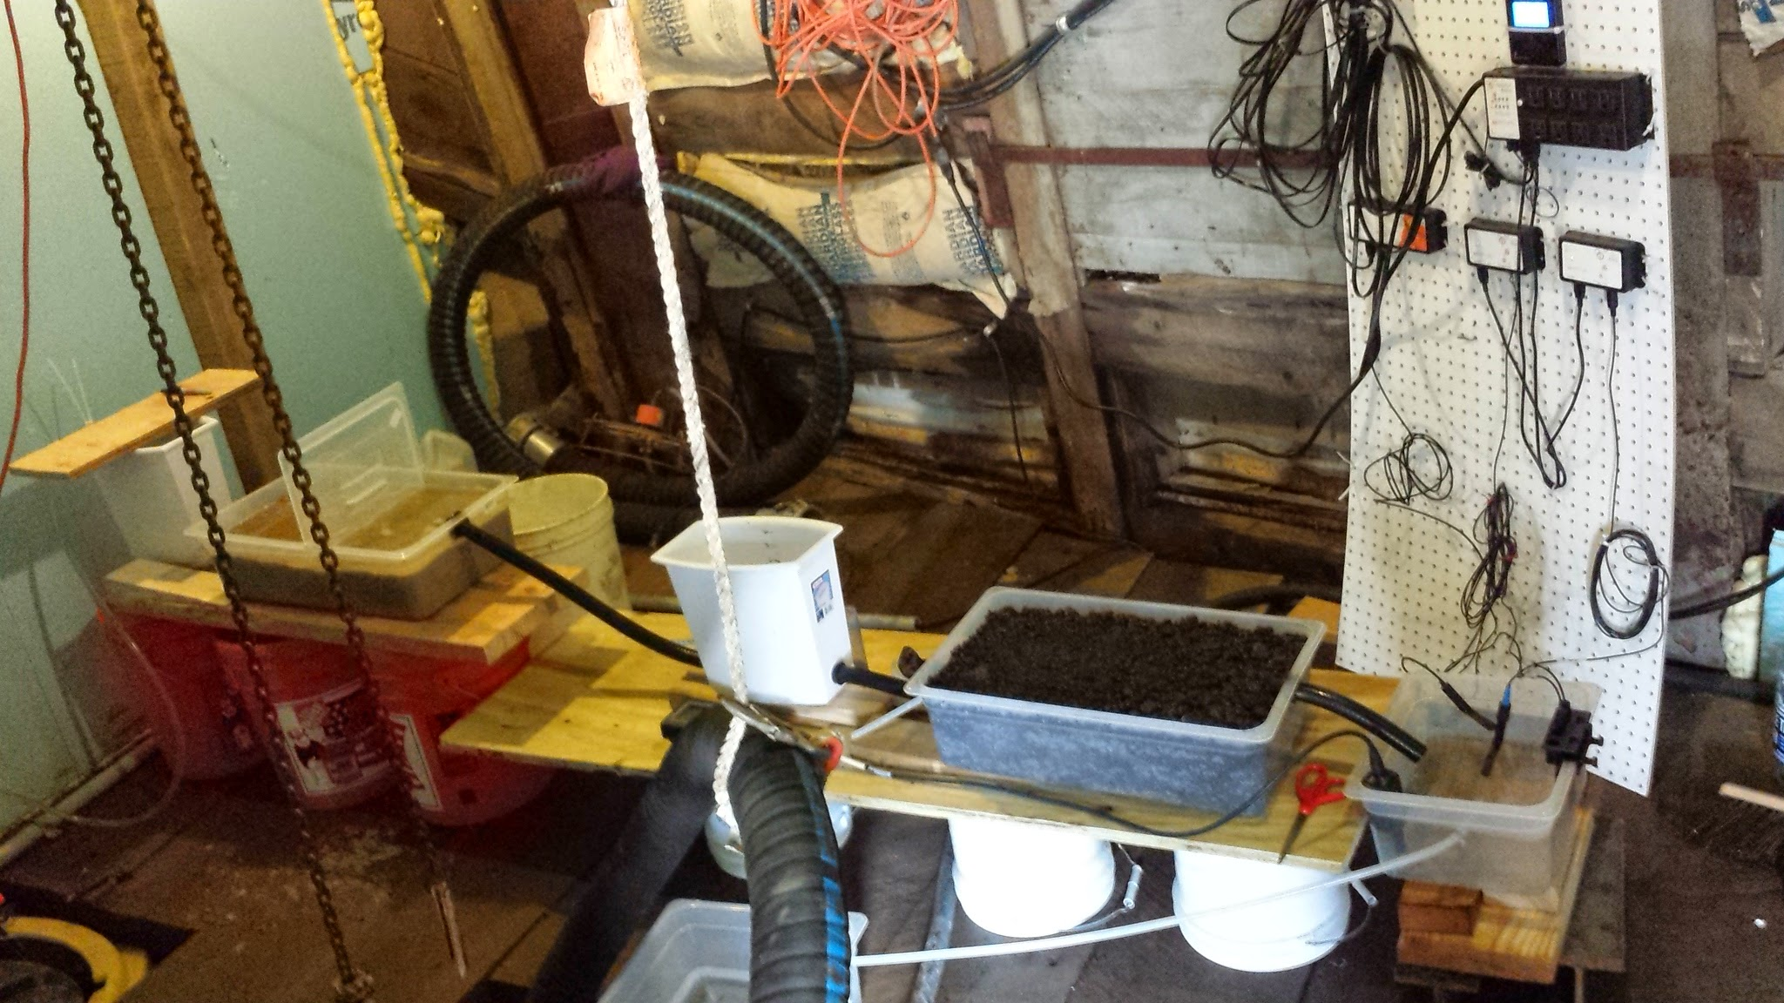
Treasury Portal Pilot System

Slide 17
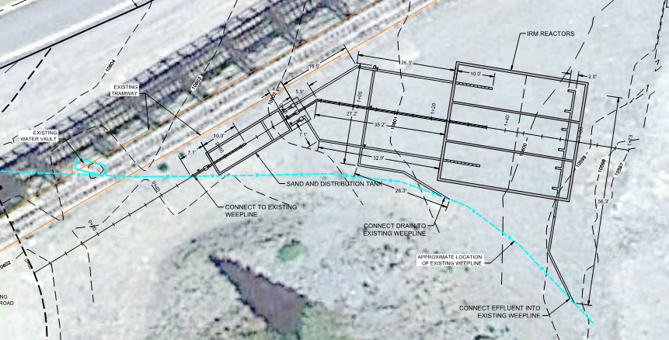
Reactive Media Reactor Design

Slide 18
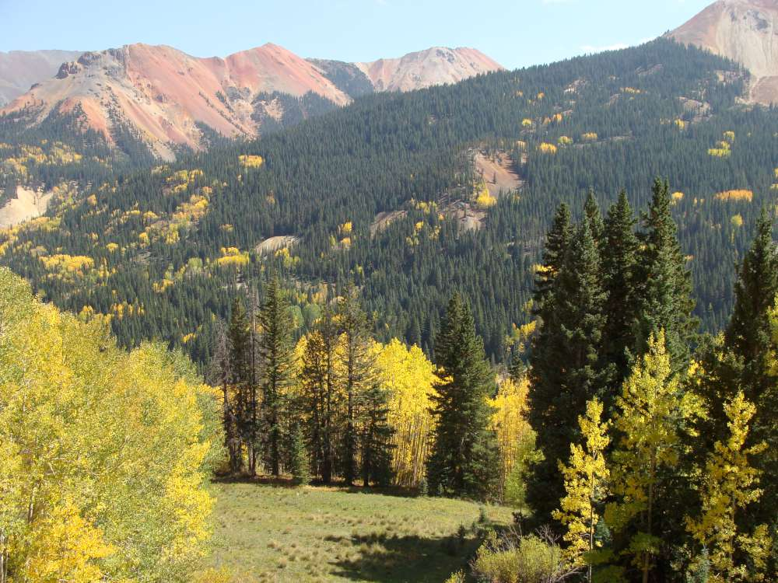
Zinc Removal Reactor System
Field parameters will be monitored continuously
Periodic monitoring of influent/effluent for relevant parameters
Parallel cells provide redundancy and scaleability
Media will require periodic replacement
Media has been tested for TCLP

Slide 19
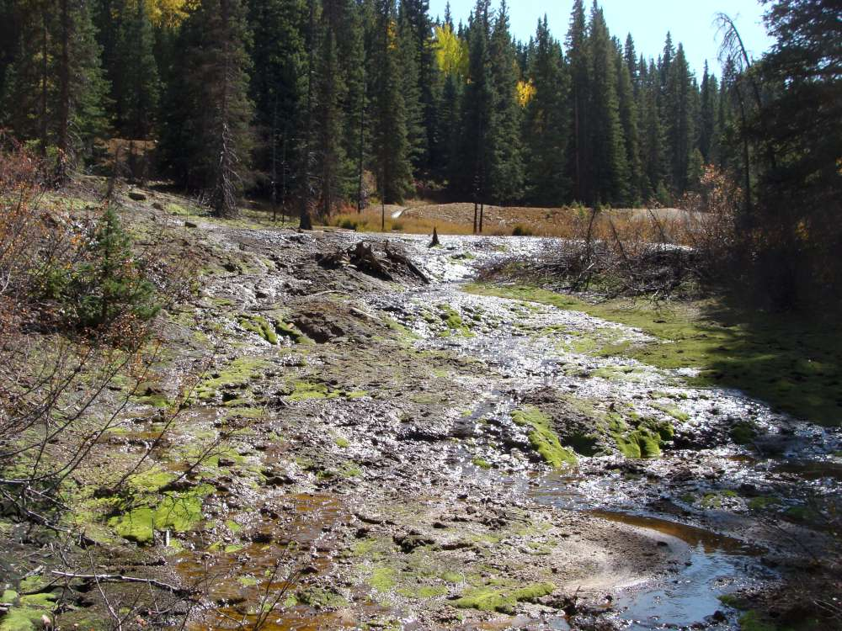
Paths Forward
Buffering! Buffering! Buffering!
Oxygenation – trompes, bubblers, cascades
Continue source controls where possible
Awareness, Education, Social Will

Slide 20
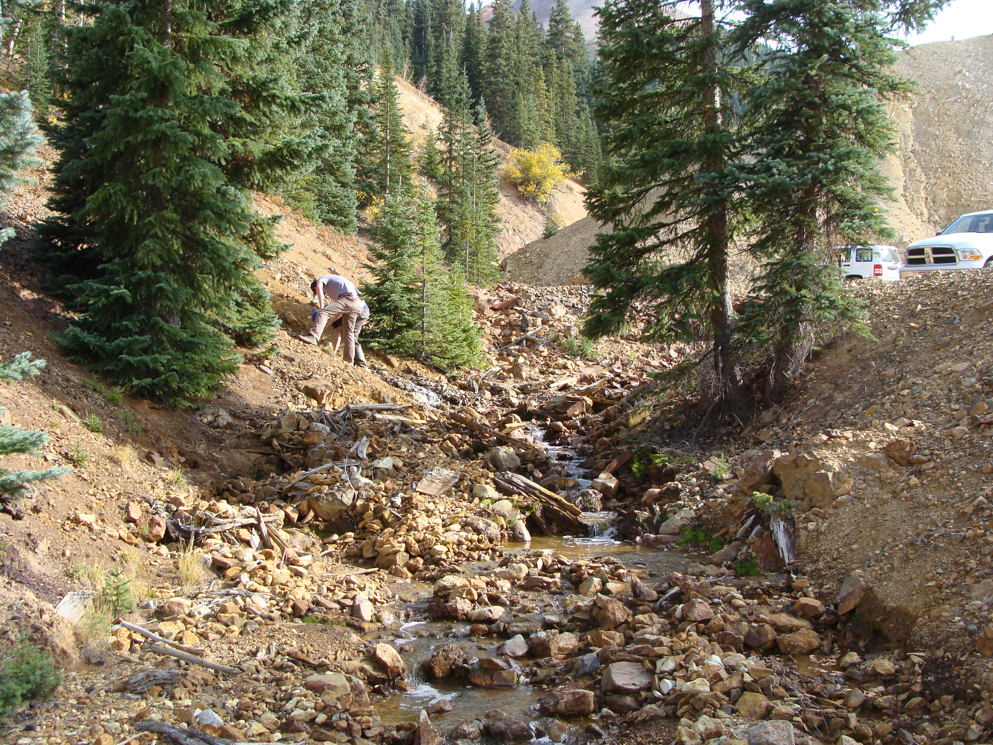
Special thanks to -
Colleagues at Worthington Miller Environmental
Idarado/Newmont Mining Company
David Levy PhD – Axis Geochemical Consulting

Slide 21

QUESTIONS?

