Slide 1
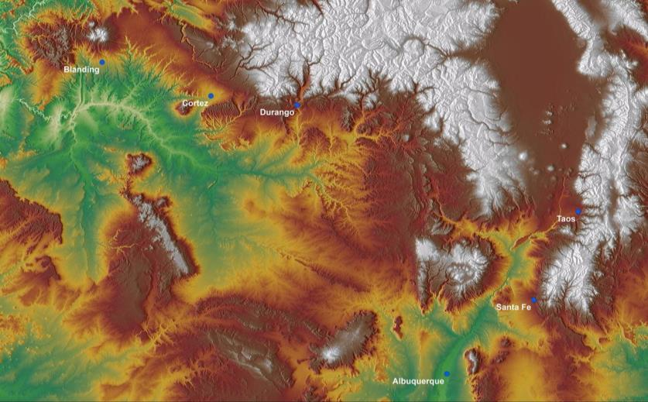
The Village Ecodynamics Project:
Modeling Pueblo Historical Ecology
A.D. 600 – 1760

Slide 2
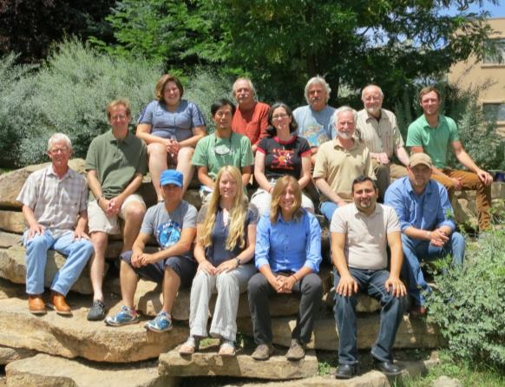
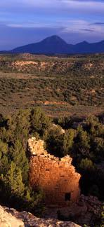
Village Ecodynamics Project (VEP)
The VEP conducts empirical studies and modeling to examine interaction between Pueblo Indians and their environment between A.D. 600 and 1600 and use the results of this research to better understand human social evolution

Slide 3
Research and Education Sponsored
by the National Science Foundation
Dynamics of Coupled
Natural and Human Systems

Slide 4
Institutional Partnerships

Slide 5
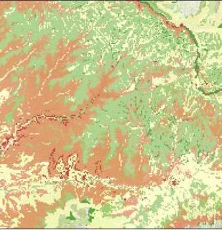
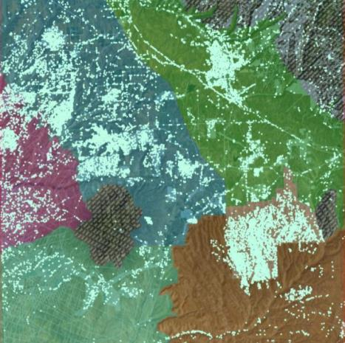
The VEP Integrates a Computer Simulation and
the Analysis of All Known Archaeological Sites
in Our Two Study Areas
Modeling agricultural productivity
for use in the computer simulation
Synthesizing information to model
population dynamics of sites

Slide 6
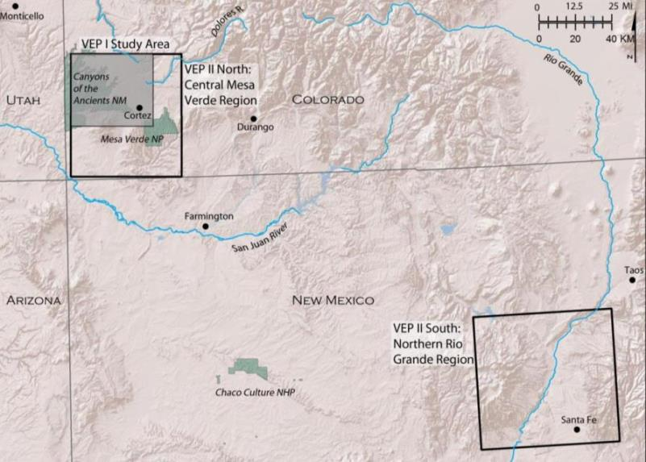
Village Ecodynamics Project II:
Ancestral Pueblo Settlement in SW Colorado and the
Northern Rio Grande: AD 600-1280

Slide 7
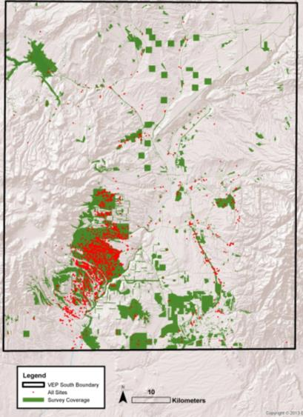
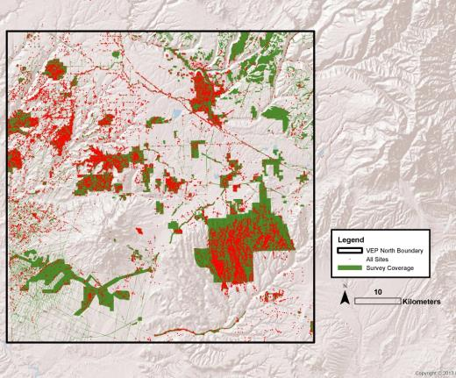
Archaeological Sites Database
VEP South Study Area
VEP North Study Area
18,000 sites, 7600 habitations
6,000 sites, 1750 habitations

Slide 8
VEP II CMV Population History

Slide 9
Revised Population History

Slide 10
A New Look at MVR and NRG Population
UPDATE

Slide 11
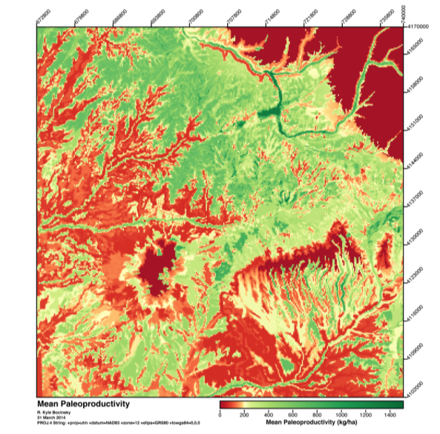
The Village Ecodynamics Project:
Average Agricultural Yields A.D. 600–1300
(Image Courtesy Kyle Bocinsky)

Slide 12
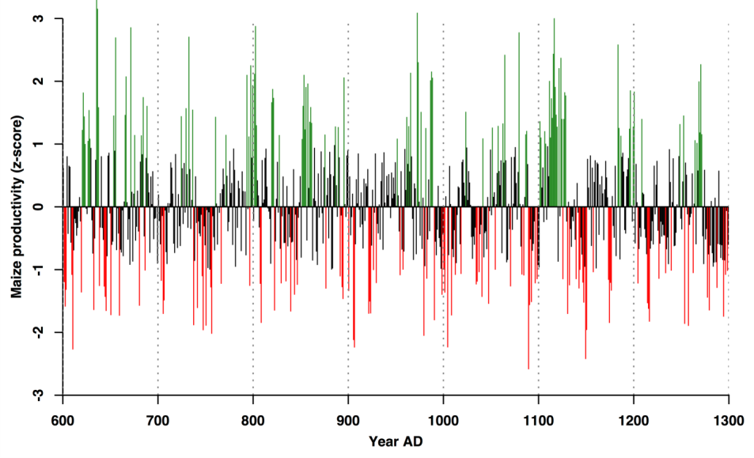
Annual Maize Productivity A.D. 600–1300:
The Village Ecodynamics Project
(Image Courtesy Kyle Bocinsky)

Slide 13
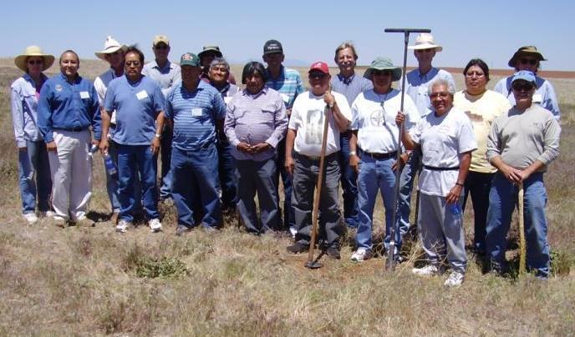
American Indian Partnerships:
The PFP Planning Meeting

Slide 14
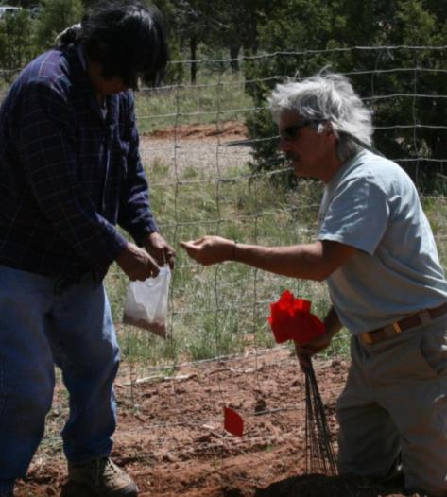
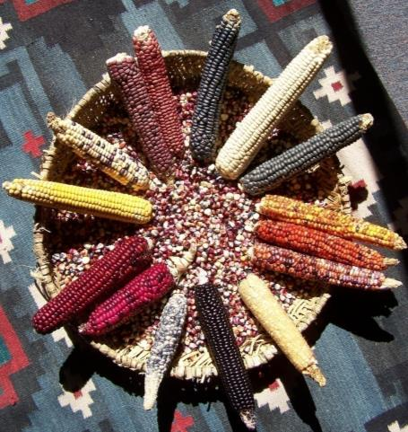
The Pueblo Farming Project
Hopi Farmers Provide the Seed for Planting
Harold Polingyumptewa and Paul Ermigiotti

Slide 15
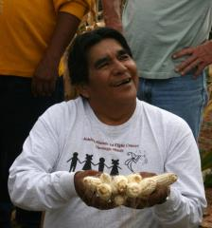
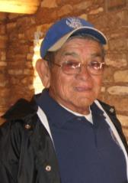
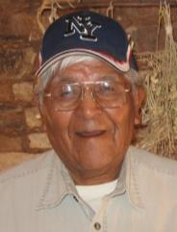
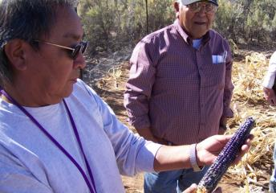
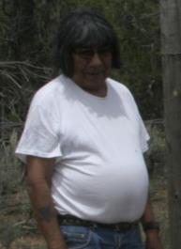
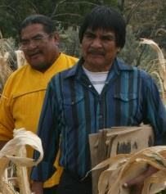
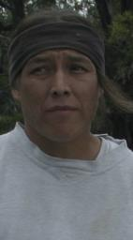
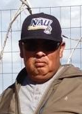
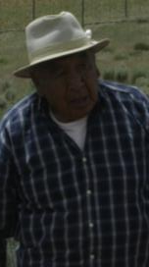
Hopi Farmers
Lee Wayne
Lomayestewa
Owen
Numkena
Raleigh
Puhuyaoma
Leigh
Kuwanwisiwma
Morgan
Saufkie
Stewart
Koyiyumptewa
Ahkima
Honyumptewa
Harold
Polyingyumptewa
Donald Dawahongnewa
Ronald Wadsworth

Slide 16
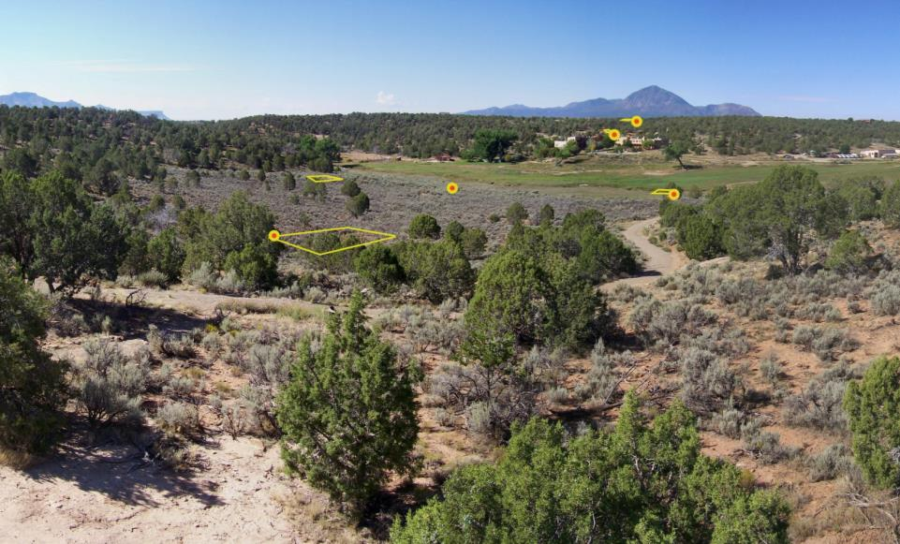
Location of Experimental Gardens

Slide 17
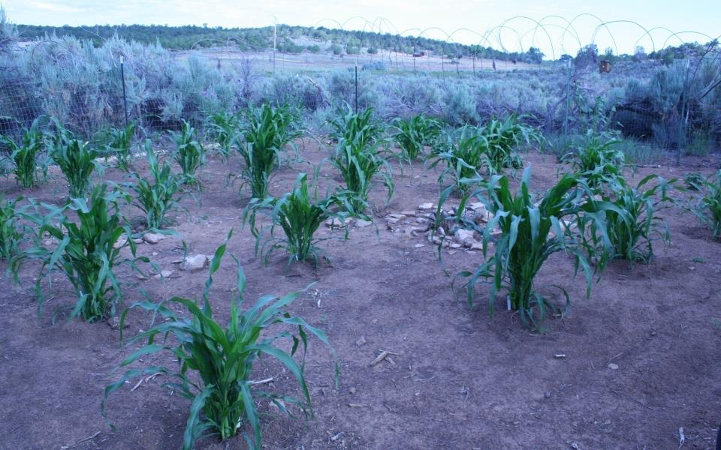
The Check Dam Garden

Slide 18
Comparing VEP Computer Estimates
with PFP Actual Yields:
Aggregated Data

Slide 19
VEP Related Education Products:
NSF-CRPA Grant and Other VEP Funding
Exhibits at the new History Colorado Center in Denver
New online, distance-learning VEP educational product
Educational computer game focused on Pueblo farming practices

Slide 20
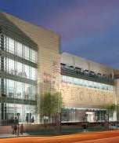
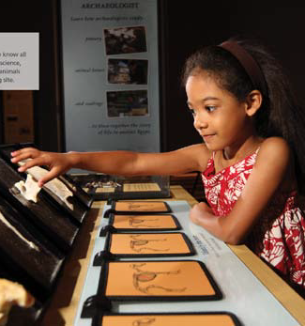
History Colorado Museum
NSF-CRPA Grant to Develop Exhibits

Slide 21
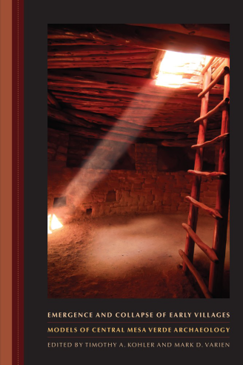
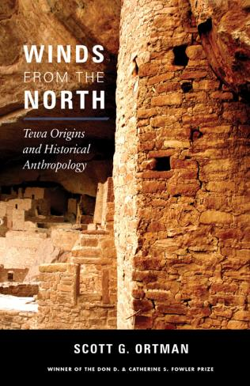
Publications for the
Profession and the Public

