Slide 1
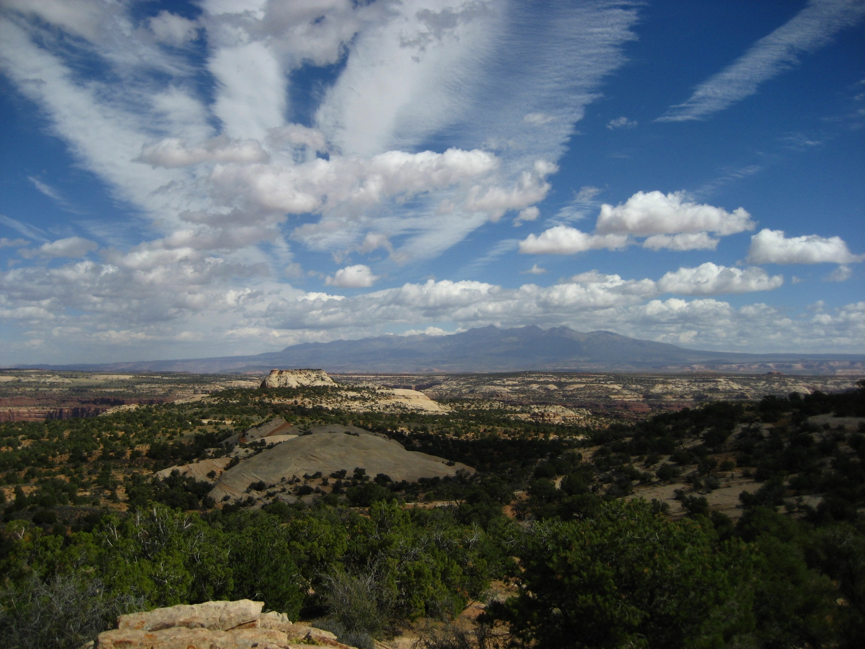
“The Lay of the Land”

Slide 2
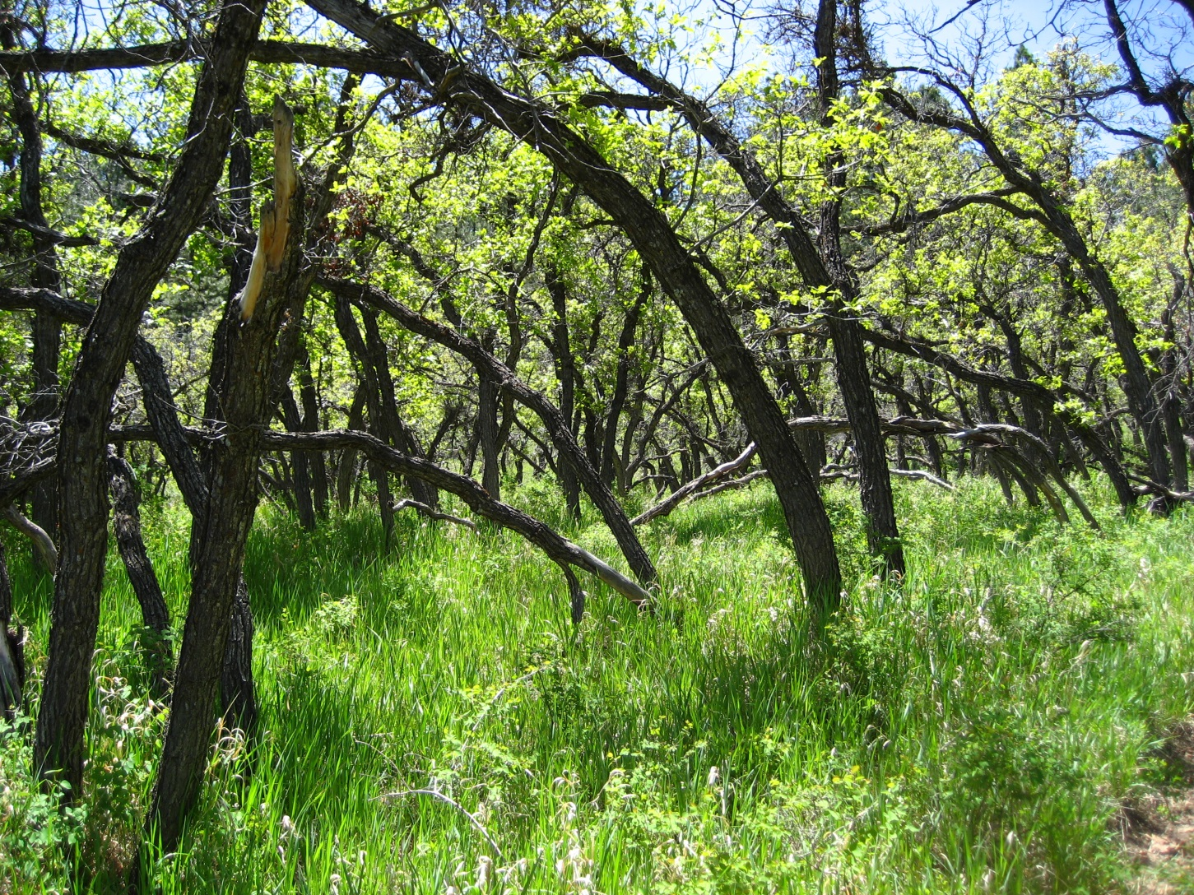
New Partnership

Slide 3
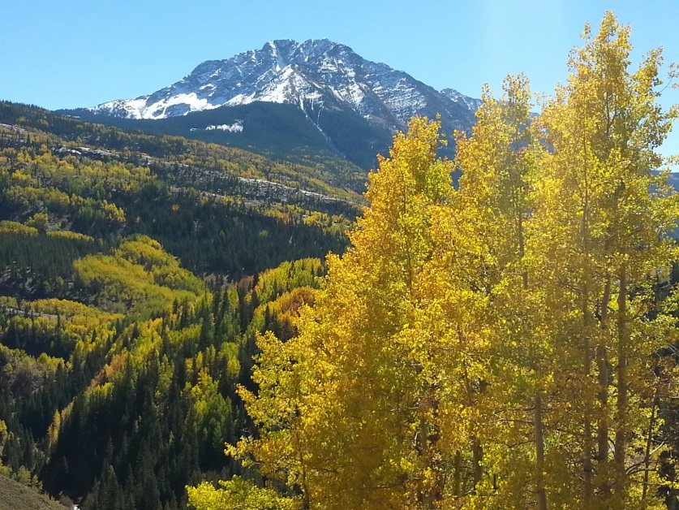
Forest Health
Focus: Invasive Species
Activities:
Coordinate central data base
ID/Inventory species across
jurisdictions
Develop common vision
Use a monitoring protocol
Share/leverage resources
Hire a coordinator to oversee this effort
Engage communities
Next step: Gary continues conversation

Slide 4
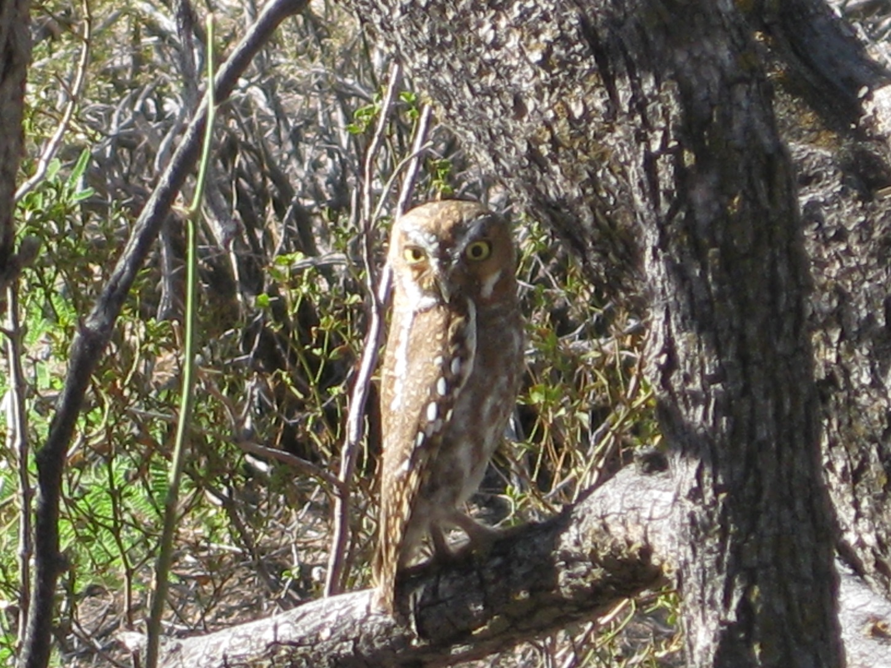
Data Sharing (Wisdom/Knowledge)

Slide 5
Climate Change
Goals:
Collect data
  Identify data and high grade for good data
  Data cell
  Determine data need
Synthesize and analyze
  Establish framework for info
  Project cell for existing projects
  Establish a think tank – Kara, Heidi, Jeff, Chris, Marci, Rob & Jimbo
Share information
  Repository for info and tools – MSI and funding
  Develop dissemination tools
  Econ think tank—biomass, business roundtable (Marcie and Jimbo)

Slide 6
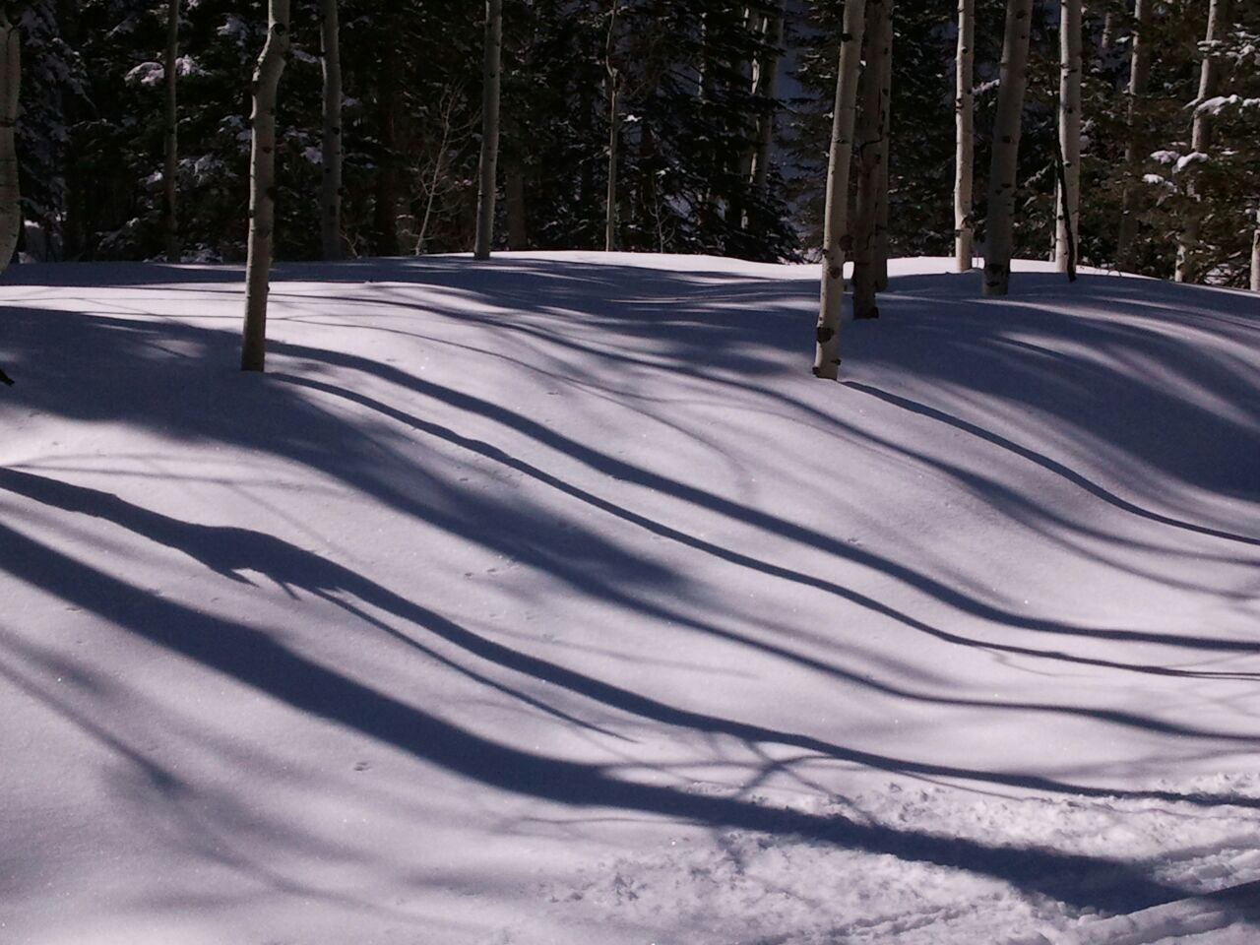
Project Ideas to Fill Gaps

Slide 7
Education: Fill Gaps
Gaps that need addressed
  Educate about the economics of conservation & the value of the resources (i.e., assessment, report, tax?)
2) Climate Change Education (clearinghouse of resources for educators & develop tools and materials) (maybe put on CC list?)
3) Prevent Resource Damage Through Reducing Violations using Education (Peer pressure)

Slide 8
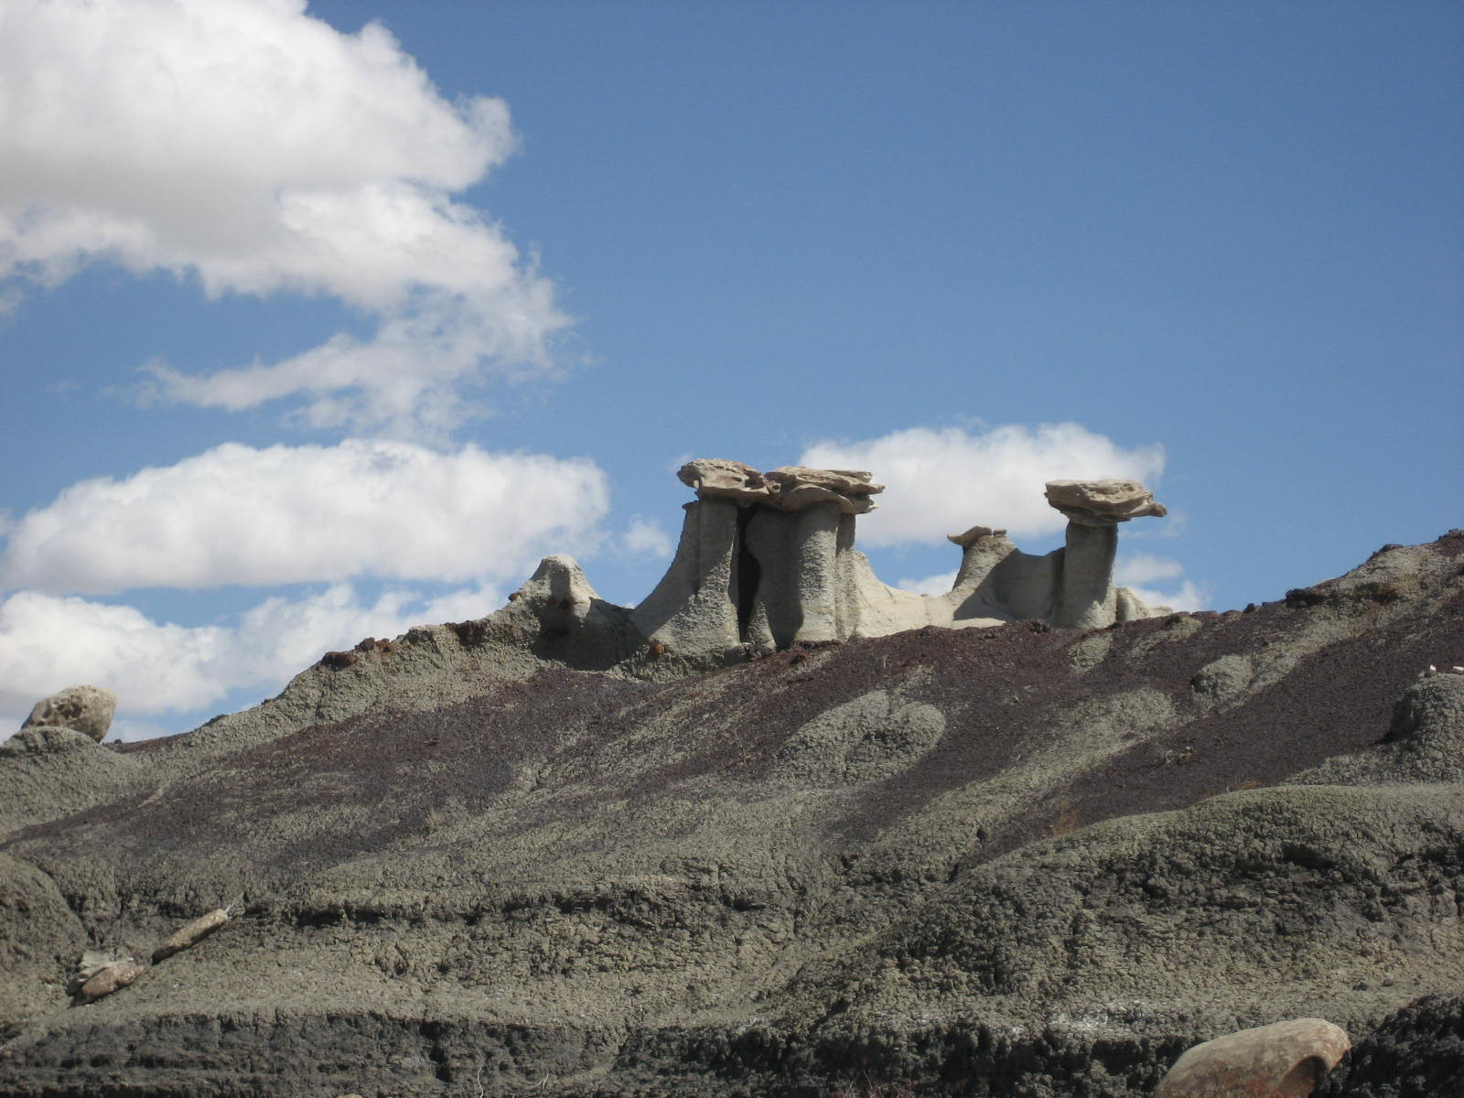
Make Better Use of Existing Resources

Slide 9
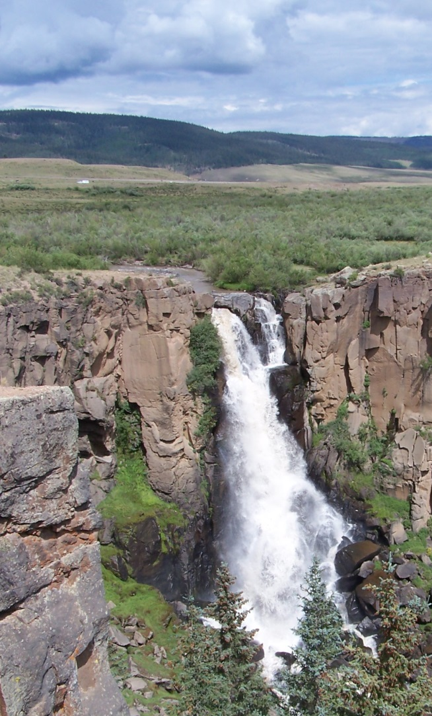
Water
Don’t need a new collaboration:
existing ones can be strengthened
and can benefit from sharing; already many water
collaboratives
2. Need: get unusual suspects involved
Denise Rue –Pastin, Water Information
Program, will post events, studies,
water resources, etc… on the existing website
she manages: (www.waterinfo.org) such as:
        Water calendar
        Education opportunities
        Water projects
        Job fairs
        Water studies
        Volunteer opportunities
        Events & Ways for the public to get involved

Slide 10
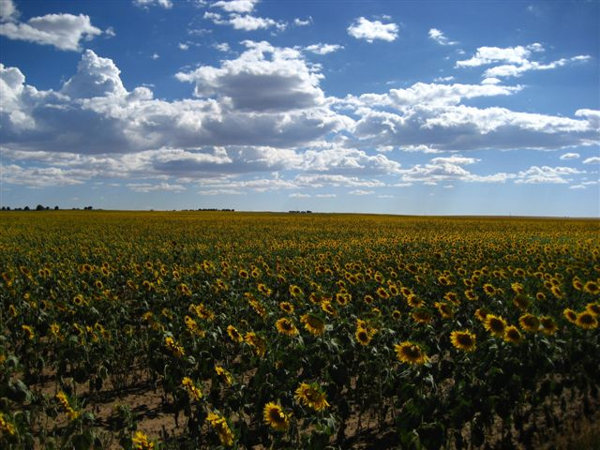
Relationship Building

Slide 11
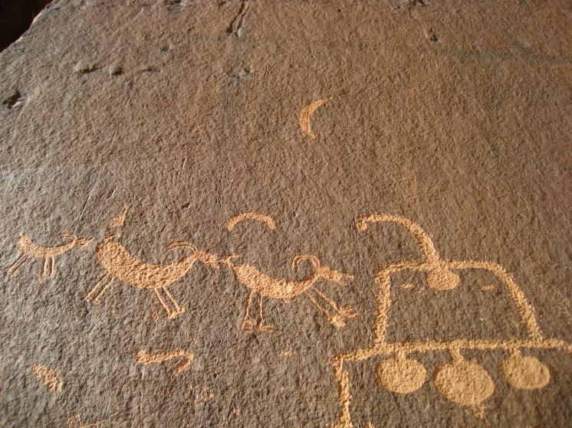
Archeology
Concluded that the Partnerships
& Relationships were already there so…
Need to explore ideas to get our
work done on the ground due to less $$$
a. Volunteers, companies, etc…
2. How do we make cultural resources relevant?
a. To the public, gov’t agencies, etc…
Need to work across agency /disciplinary boundaries
4. Relationships were established but session made them stronger than before

Slide 12
Economics/Conservation
Challenges:
1. Identifying sources of funding
2. Challenges with continuity of funding and priorities
3. Changing funding world
4. Lack of knowledge base of small organizations and non-profits
Discussed ways members of the group might partner
Made connections
Realized a watershed connects members (Animas)
Realized lack of knowledge base about each other and other small organizations in the same watershed working toward the same goals

