Slide 1
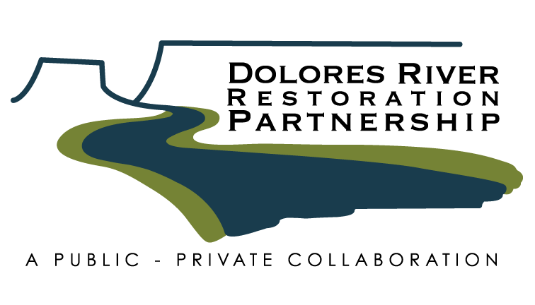
Daniel Oppenheimer
Tamarisk Coalition
May 20, 2014

Slide 2
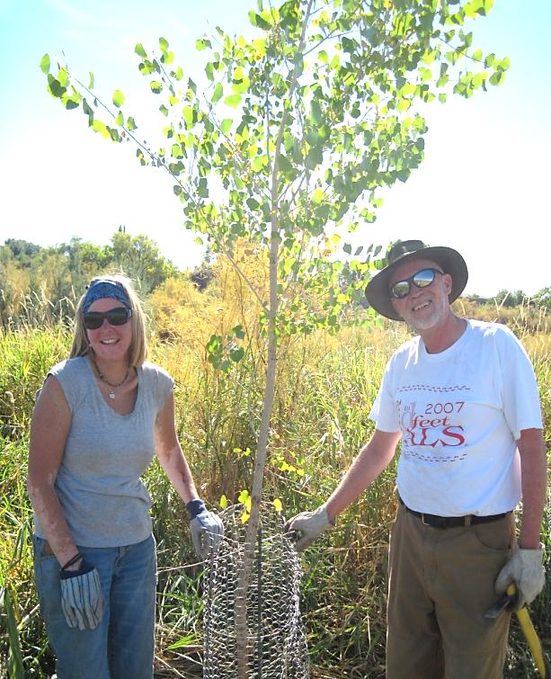
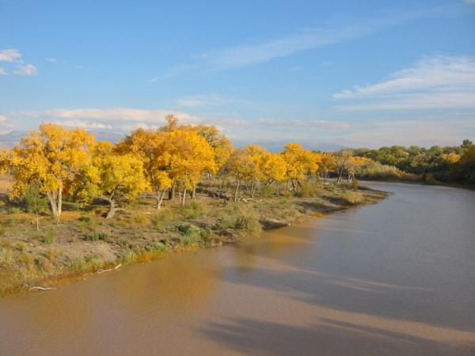
Restore. Connect. Innovate.
Tamarisk Coalition
Our Mission
Advancing the restoration of riparian lands through collaboration, education, and technical assistance.
Our Vision
We envision healthy and self-sustaining riparian ecosystems throughout the American West resilient to invasive plant species and supported by enduring communities of stewards.

Slide 3
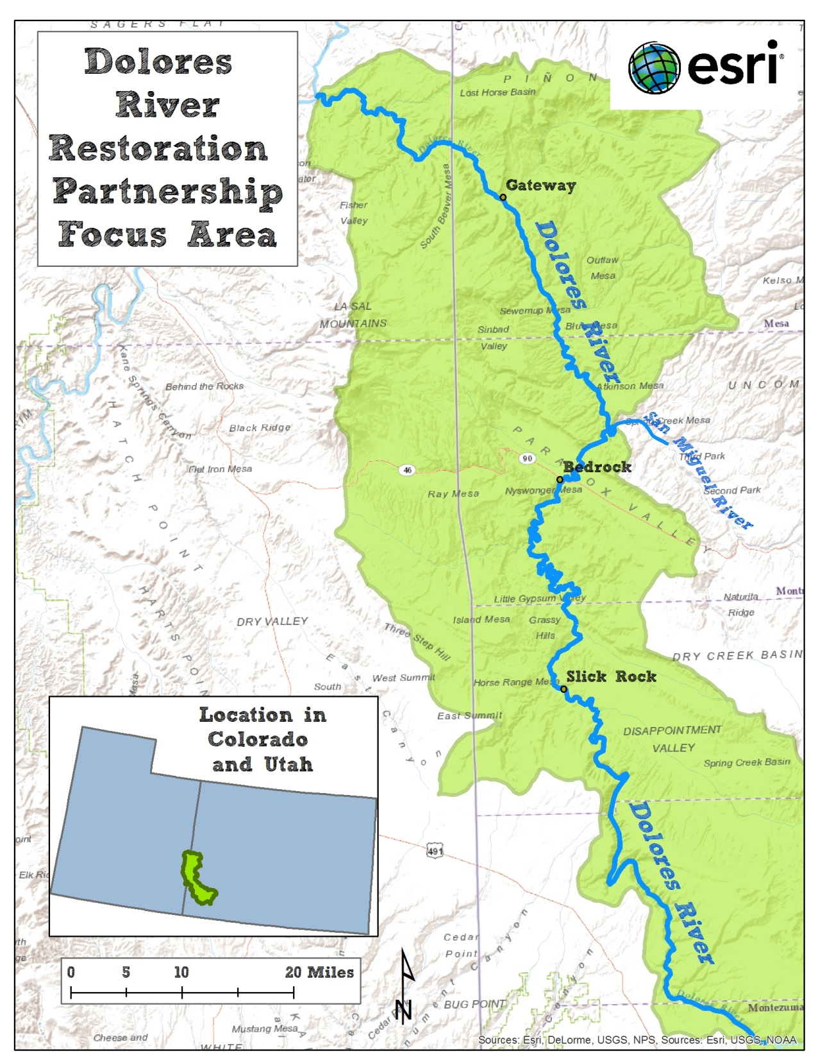
The DRRP project area includes:
175 miles of the Dolores River in Southwest CO & Southeast UT
Several tributaries to the Dolores, including the San Miguel River & Disappointment Creek
2 states, 4 BLM field offices, 6 counties, and nearly 20 volunteering private landowners

Slide 4
A shared problem recognized in 2009:
Along nearly 200 miles of the Dolores River, noxious weeds had displaced native plant communities, impaired wildlife habitat and forage, hindered recreational opportunities, and increased risks associated with wildfire.

Slide 5
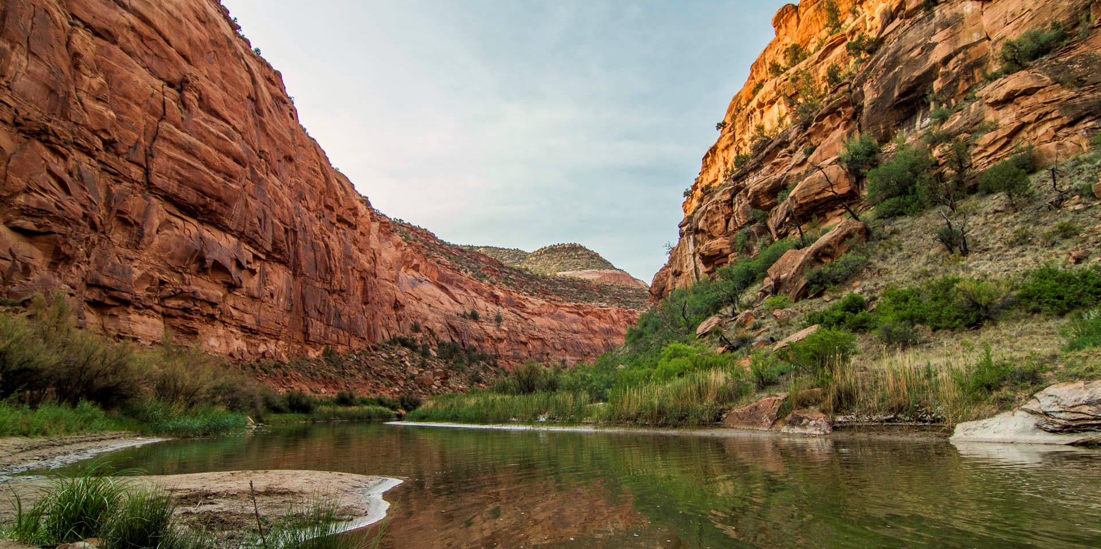
DRRP Vision: The Dolores River watershed is dominated by native vegetation, where the threats from tamarisk and other associated invasive species have been mitigated and the riparian areas of the watershed continue to become more naturally functioning, self-sustaining, diverse, and resilient over time.

Slide 6
4 Shared Partnership Goals:
Ecological Goals: enhanced plant communities
Social Goals: youth, public safety, and aesthetics
Economic Goals: employment, local investments, efficiency, and recreation
Management Goals: learning, sharing, and improving

Slide 7
20 Signatories to MOU (below), plus many new partners since
Bureau of Land Management: Tres Rios, Uncompahgre, Grand Junction, and Moab Field Offices;
Colorado Parks and Wildlife;
Counties of Dolores, CO, San Miguel, CO, Montrose, CO, Mesa, CO, and Grand, UT;
Four Corners School - Canyon Country Youth Corps;
Natural Resources Conservation Service;
Rocky Mountain Bird Observatory;
Southwest Conservation Corps;
Tamarisk Coalition;
The Nature Conservancy;
University of Utah – Rio Mesa Center;
U.S. Fish and Wildlife Service, Partners for Fish and Wildlife;
Walton Family Foundation;
Western Colorado Conservation Corps

Slide 8
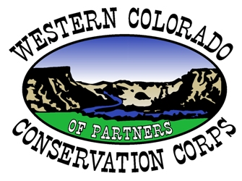
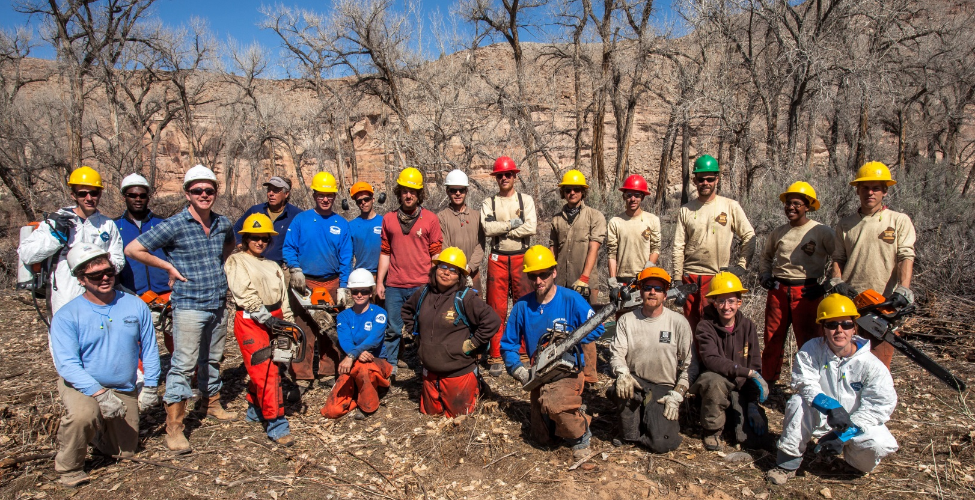
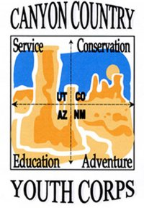
Conservation Corps Crews:
Building Capacity, Creating Jobs, Fostering Stewardship, & Developing Future Conservation Leaders
Corps: Building Capacity, Creating Jobs, Fostering Stewardship, Future Conservation Leaders

Slide 9
DRRP Organizational Diagram – March 2014
Dolores River Restoration Partnership
Public land managers, private landowners, universities, nonprofits, technical experts, private foundations, and other stakeholders
Provides Directives
Technical Experts
Advisory
Core Team
BLM, TNC, TC, Conservation Corps, and Facilitator
Seeks guidance
Subcommittees
Implementation
Science &Monitoring
Funding
Outreach &Education
Coordinates across &
provides assistance

Slide 10
Key Partnership Resources
Dolores River Riparian Action Plan (2010):
a stakeholder-designed 5-year strategic plan
provides framework for shared vision, goals, and criterion for prioritizing restoration work.
Memorandum of Understanding (2010):
affirmed roles and responsibilities
how partnership resources will be allocated & decisions made
DRRP Monitoring and Maintenance Plan (2014):
outlines long-term strategies to manage the Dolores River riparian corridor

Slide 11
What we’ve done well
Collaborative planning tools
Responsive governance
Processes for extracting and building
on lessons learned
On-the-ground work towards shared goals

Slide 12
Challenges & hard knocks
Tracking inputs and outputs across a watershed
Preparing for long-term monitoring & maintenance
(i.e. major partnership transition)

Slide 13
Tracking Inputs
& Outputs

Slide 14
Partnership transitions
“Looking back, I would have wanted to spend more time developing the instruments to carry this work out from beginning to end.”
– DRRP Partner

Slide 15
Lessons learned
Having practitioners who can cross boundaries effectively
Sharing information through a variety of avenues
Developing a shared language

Slide 16
~Healthy watersheds through healthy partnerships~
Mission: to connect practitioners through information sharing, collective capacity building, and collaboration across watersheds
Learn more at www.crosswatershed.net

Slide 17
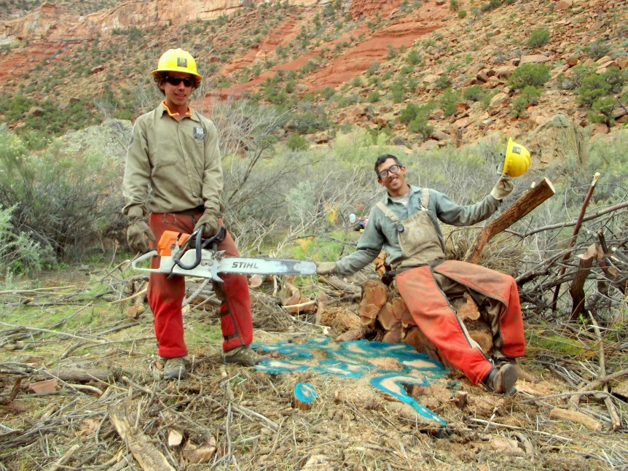
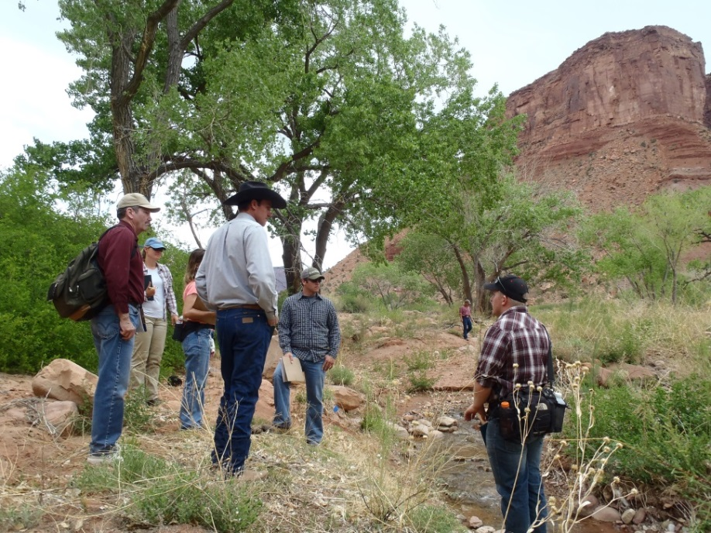
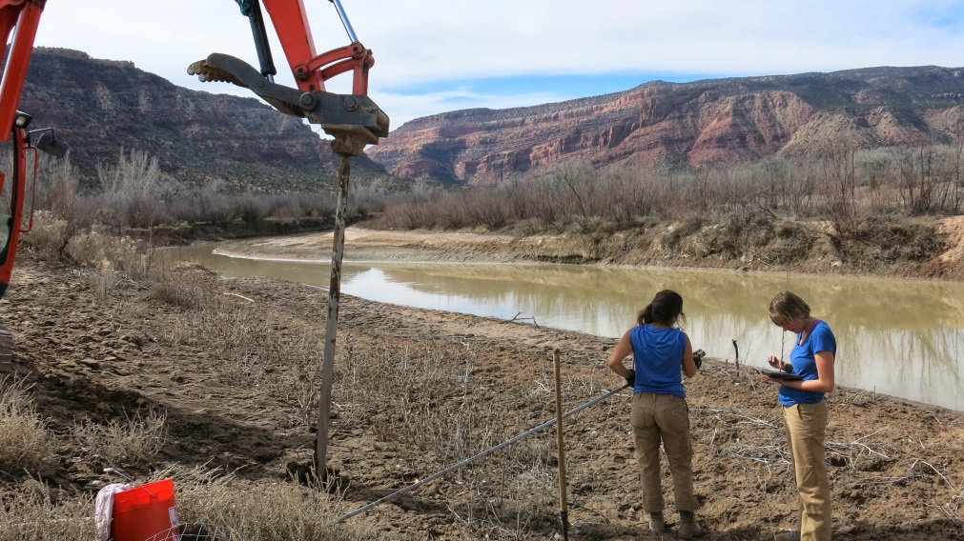
To learn more, visit us at: http://ocs.fortlewis.edu/drrp/
Daniel Oppenheimer
Tamarisk Coalition
970-256-7400
doppenheimer@tamariskcoalition.org

